Slide 1

SESSION 01
LINQ
Language Integrated Query
.NET Track

Slide 2
Session Agenda
01
var, dynamic
02
Anonymous Type
03
LINQ Foundations
Implicit, runtime & base typing
Comparison & best practices
a Type Without name
What & Why LINQ
04
Deferred vs Immediate
05
Filtering
06
Projection
When queries actually execute
Where, OfType
Select & SelectMany
07
Ordering
OrderBy, ThenBy, Reverse
08
Mini Exercises
LINQ · Session 01

Slide 3
01
SECTION 01
var, dynamic
Understanding implicit, runtime, and base typing in C#

Slide 4
var Keyword in C#
var allows the compiler to detect the type of a variable at compile time based on the assigned value. The type is determined once and never changes.
How It Works
// Compiler infers the type from the right-hand side
var x = 10; // Compiler sees int → x is int
var name = "Ahmed"; // Compiler sees string → name is string
var price = 12.5; // Compiler sees double → price is double
// These are EXACTLY equivalent:
var list1 = new List<int>();
List<int> list2 = new List<int>();
LINQ · var, dynamic

Slide 5
var Rules and Restrictions
📋 Rules for Using var
✅ Must be initialized at declaration (compiler needs to see the type)
✅ Cannot be null at initialization
✅ Type cannot change after inference
✅ Can only be used for local variables (not fields or parameters)
LINQ · var, dynamic,

Slide 6
Why Use var?
✅ Benefits of var
Before and After
🧹 Cleaner Code
📖 Better Readability
Avoids repeating the type on both sides of =
When the type is obvious from context
// ❌ Without var - repetitive
Dictionary<string, List<int>> data = new Dictionary<string, List<int>>();
// ✅ With var - cleaner
var data = new Dictionary<string, List<int>>();
🔧 Essential with LINQ
⏱️ Easier Refactoring
Anonymous types require var — no choice!
Change return type without updating variable declarations
Don't overuse var! When type isn't obvious, explicit typing improves readability:
var result = GetData(); — What type is result ????
List<User> result = GetData(); — Clear! ✅
LINQ · var, dynamic

Slide 7
dynamic Keyword
dynamic tells the compiler: "Don't check the type now, figure it out at runtime." This disables compile-time type checking completely.
Type Can Change at Runtime
dynamic x = 10; // x is int (at this moment)
Console.WriteLine(x.GetType()); // Output: System.Int32
x = "Ahmed"; // x is now string ✅ No error!
Console.WriteLine(x.GetType()); // Output: System.String
x = true; // x is now bool ✅ No error!
Console.WriteLine(x.GetType()); // Output: System.Boolean
x = new List<int>(); // x is now List<int> ✅
LINQ · var, dynamic,

Slide 8
Problems with dynamic
No Compile-Time Safety
dynamic x = "Ahmed";
Console.WriteLine(x.Length); // ✅ Works - string has Length
x = 10; // Now x is int
Console.WriteLine(x.Length); // RUNTIME ERROR!
// RuntimeBinderException: 'int' does not contain 'Length'
// This COMPILES but CRASHES:
dynamic y = 5;
y.NonExistentMethod(); // Compiles! Crashes at runtime!
Runtime Errors Only
No compile-time protection — errors discovered late in production
Slower Performance
Runtime type resolution adds overhead on every call
LINQ · var, dynamic

Slide 9
var vs dynamic
Feature | var | dynamic
Type Known At | Compile-time | Runtime
Type Safety | ✅ Full | ❌ None
Member Access | Direct | Direct (unsafe)
LINQ · var, dynamic

Slide 10
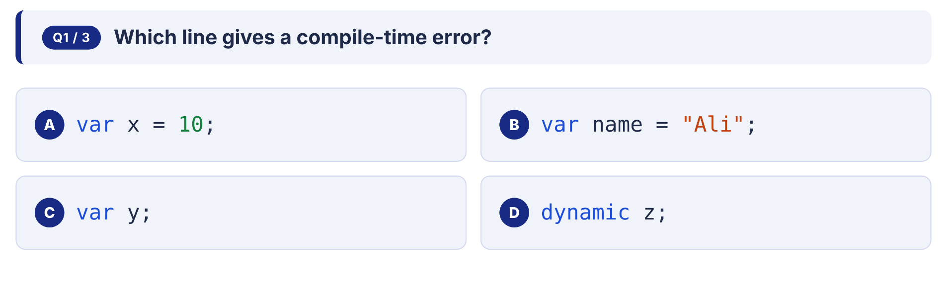
Quick Check
LINQ · var, dynamic

Slide 11
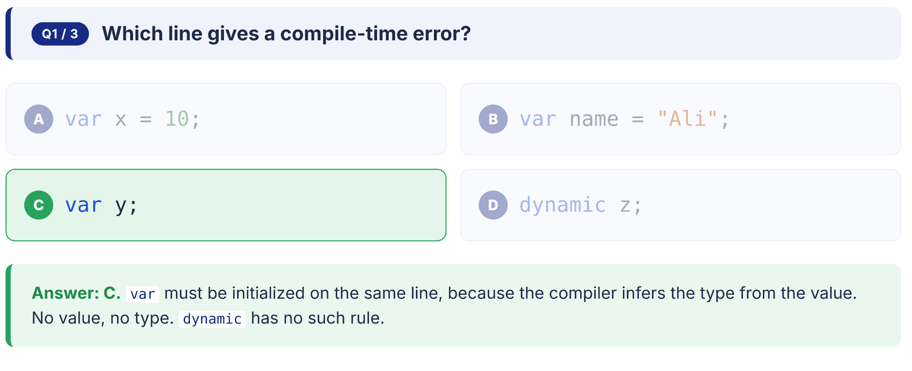
Quick Check
LINQ · var, dynamic

Slide 12
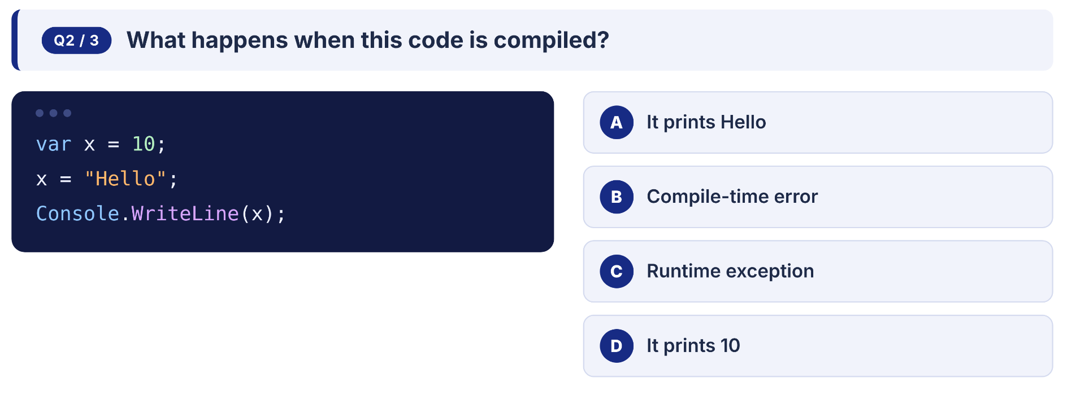
Quick Check
LINQ · var, dynamic

Slide 13
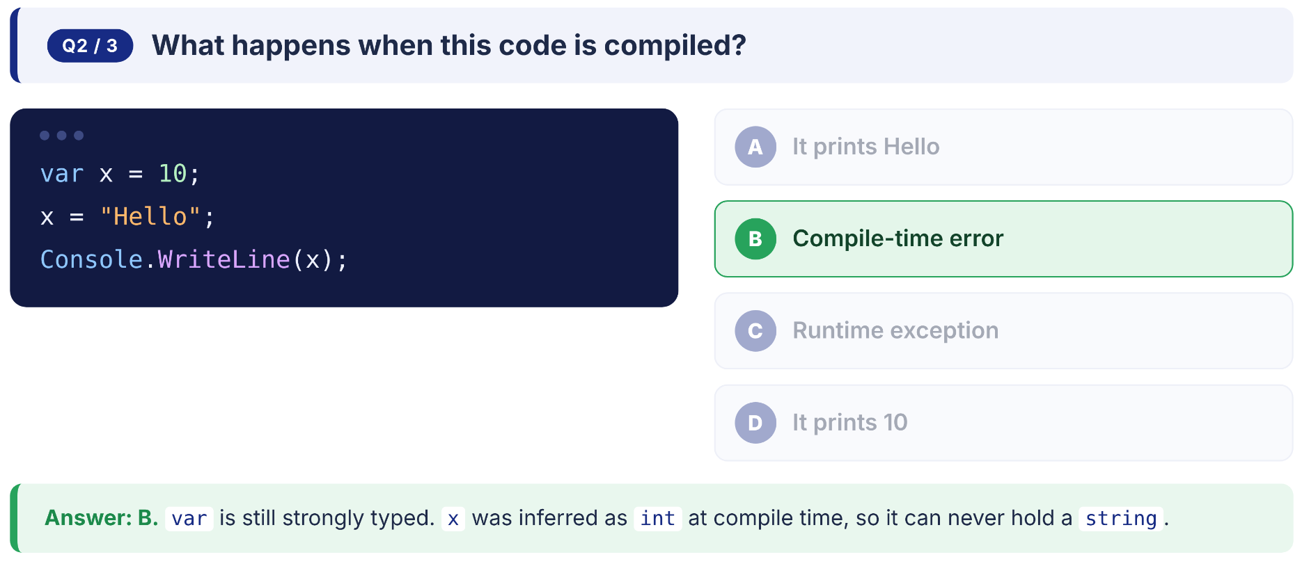
Quick Check
LINQ · var, dynamic

Slide 14
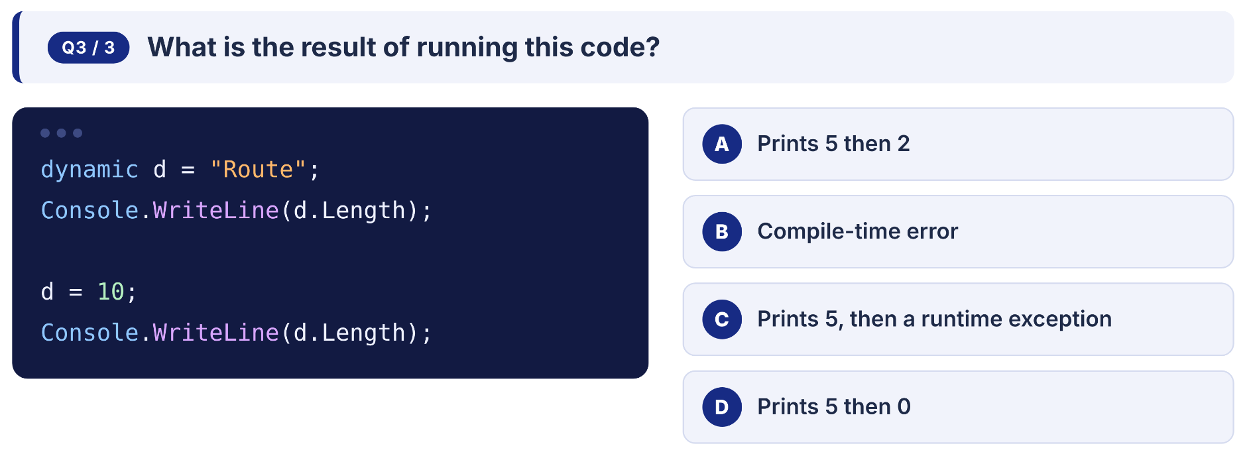
Quick Check
LINQ · var, dynamic

Slide 15
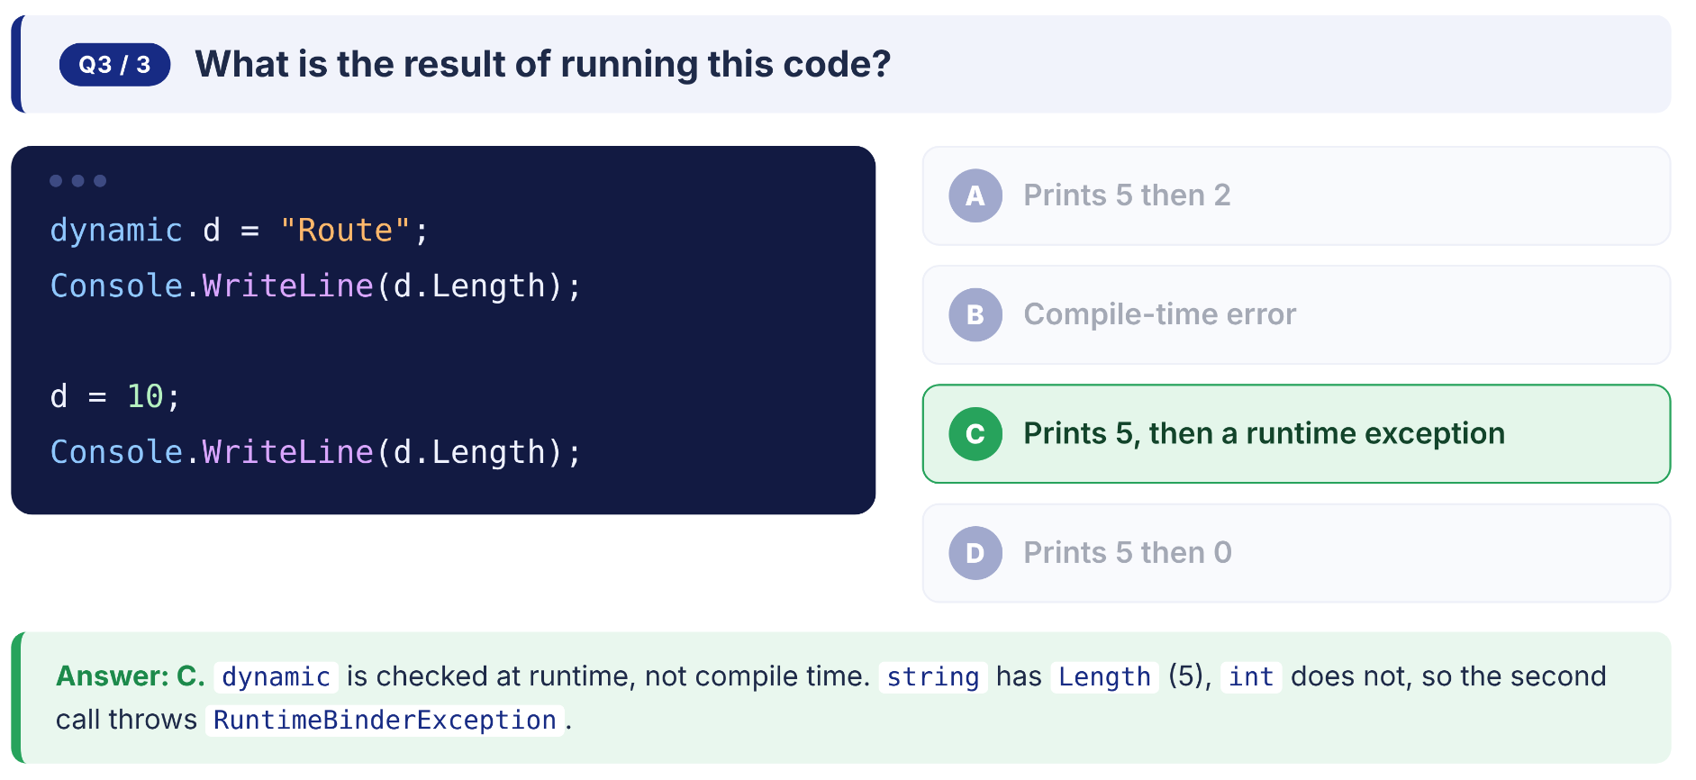
Quick Check
LINQ · var, dynamic

Slide 16
02
SECTION 02
Anonymous Type
A Type Without Name

Slide 17
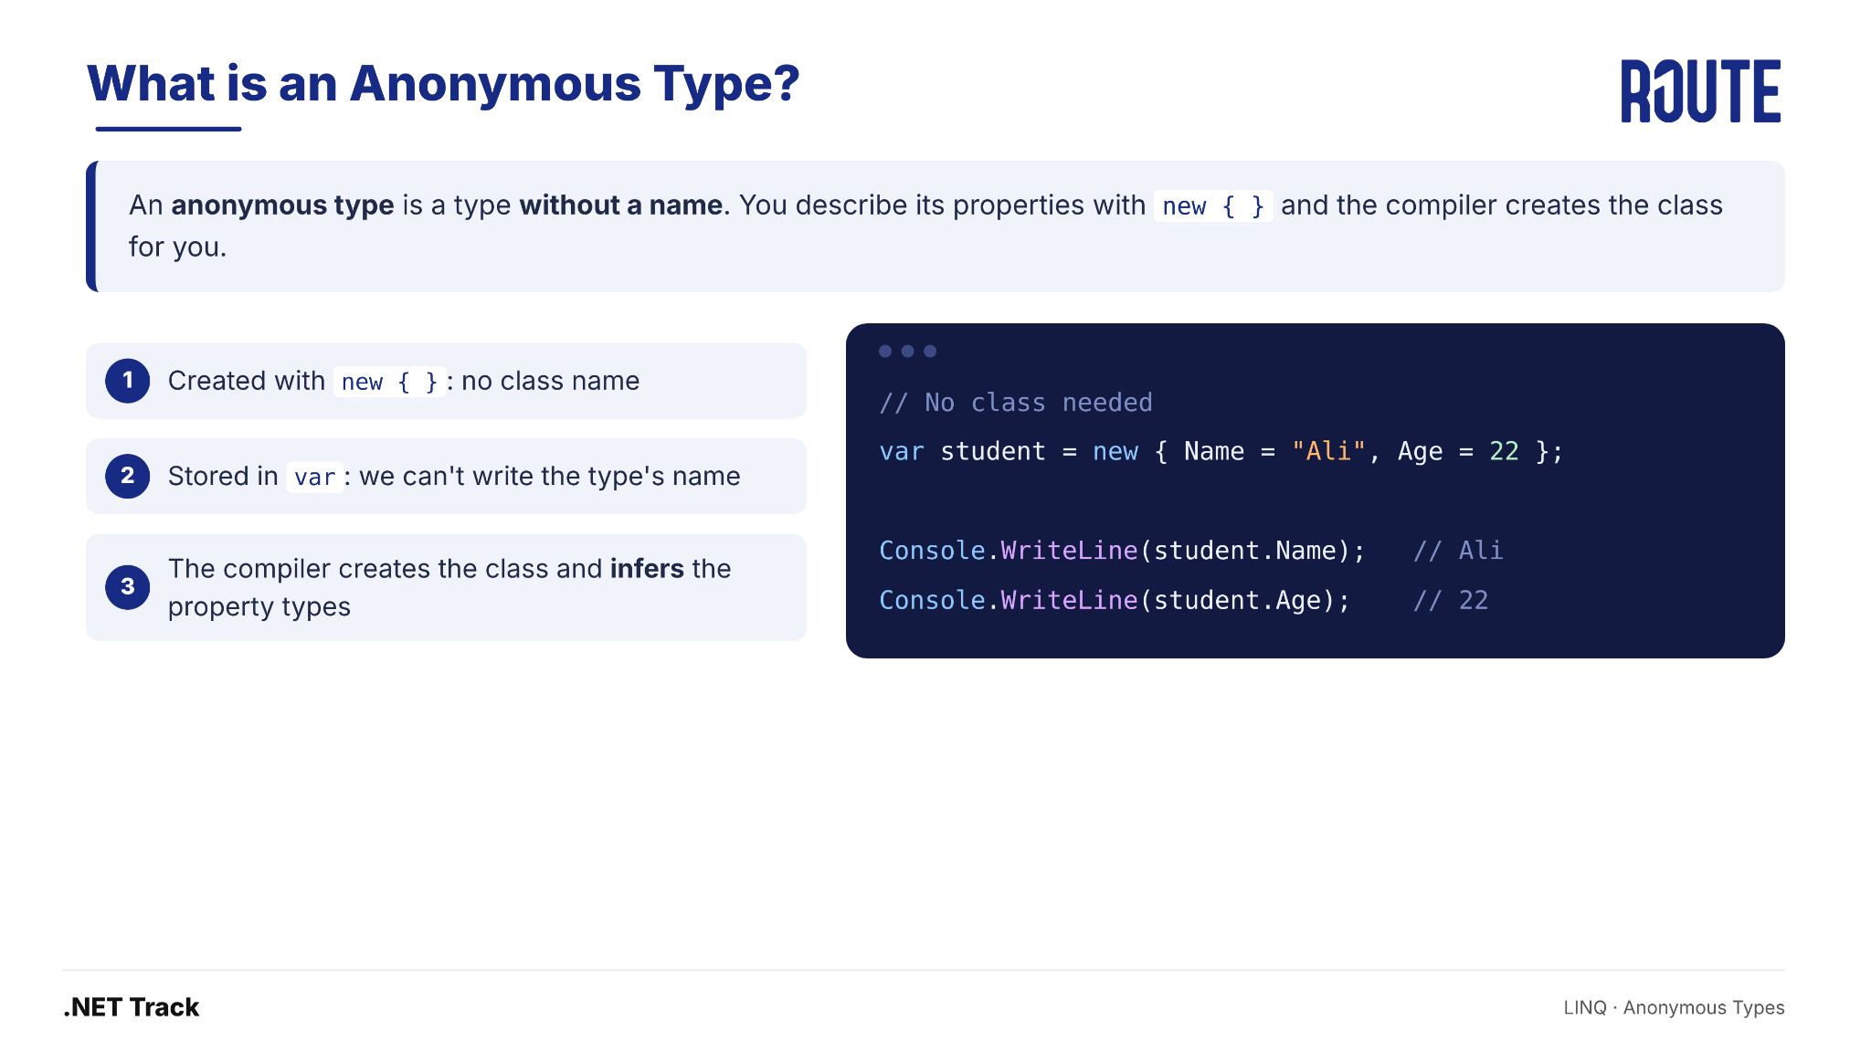
What is an Anonymous Type
LINQ · Anonymous Type

Slide 18
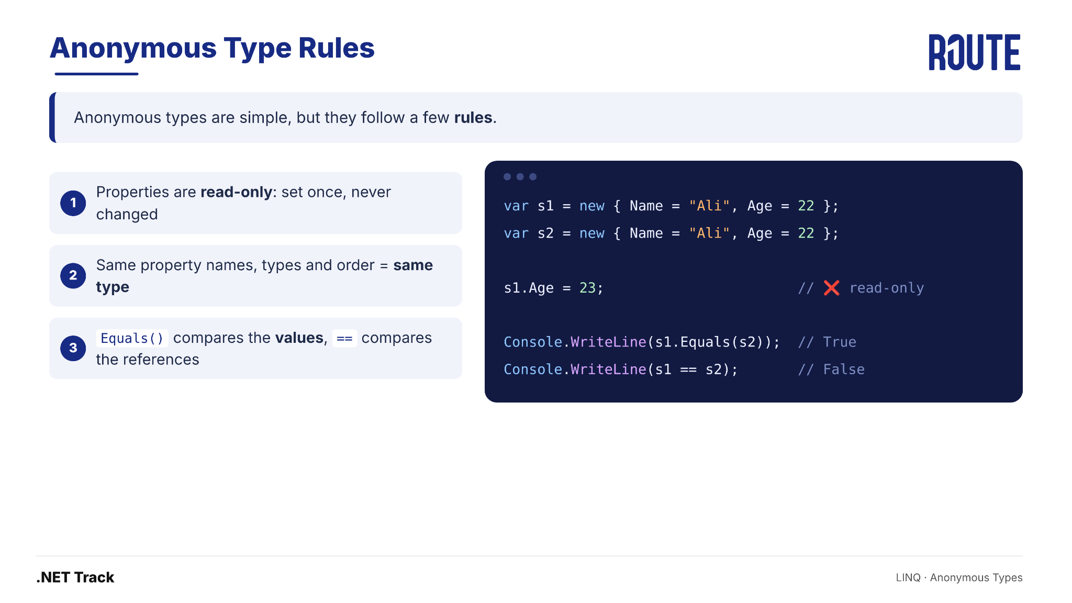
Anonymous Type Rules
LINQ · Anonymous Type

Slide 19
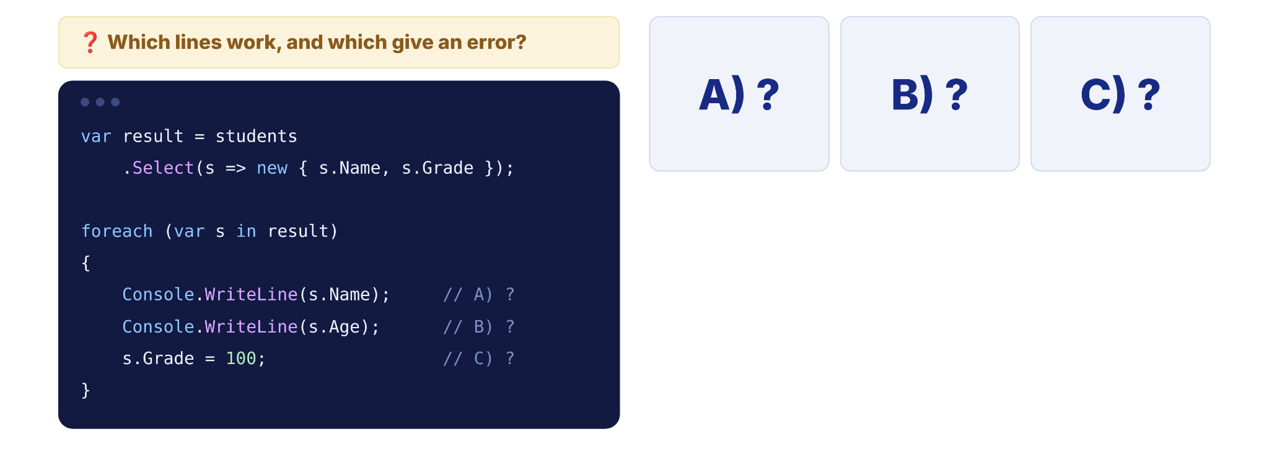
Quick Check
LINQ · Anonymous Type

Slide 20
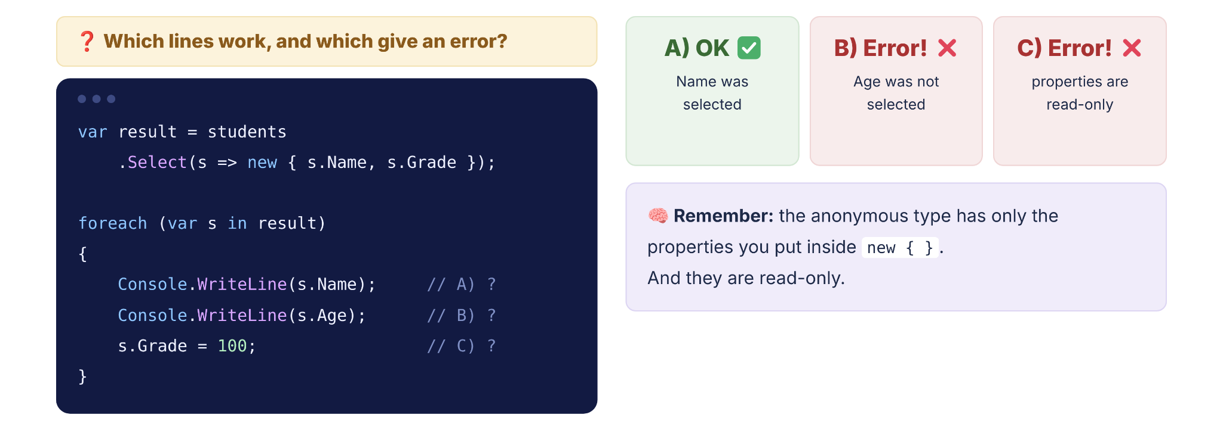
Quick Check
LINQ · Anonymous Type

Slide 21
SECTION 03
03
LINQ Foundations
Language Integrated Query — What, Why, and How it works

Slide 22
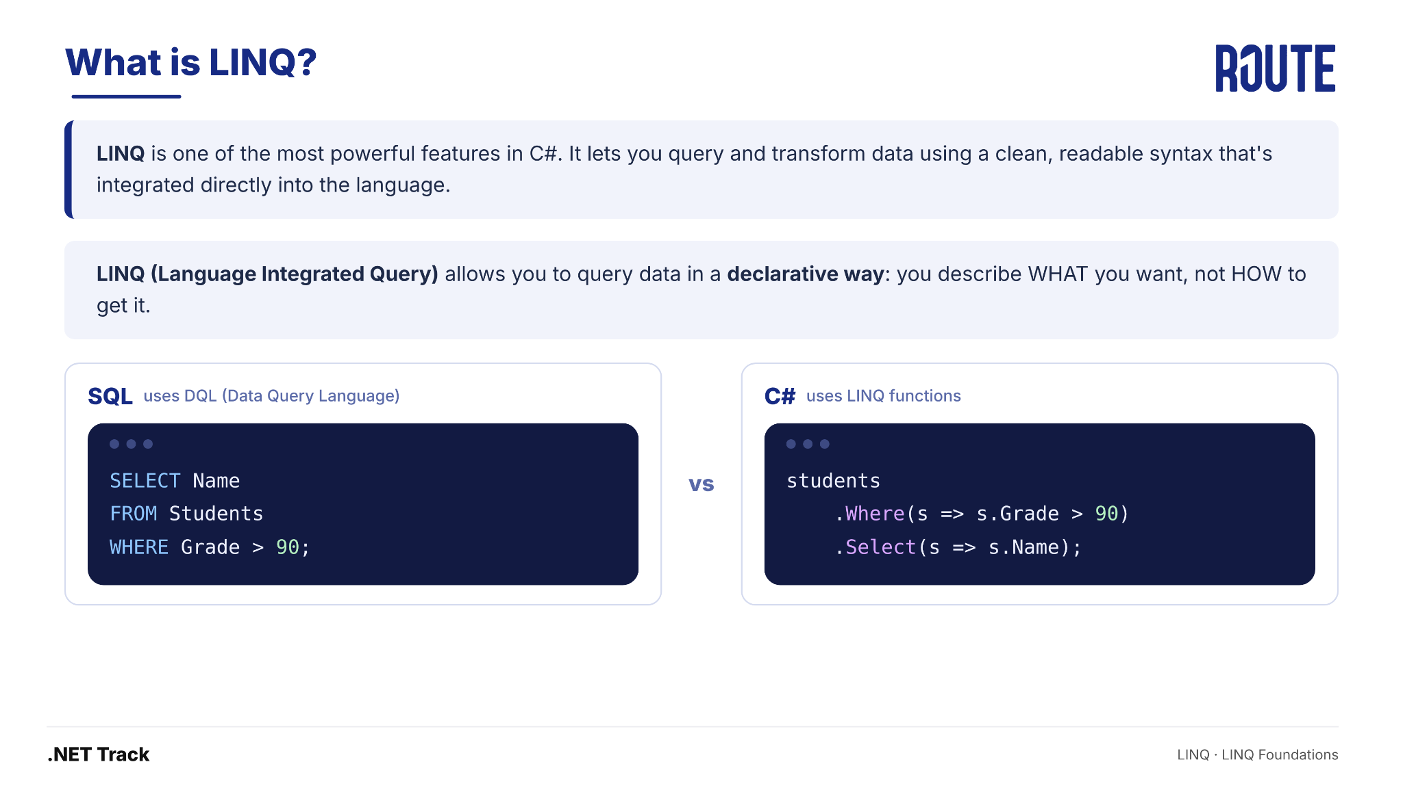
What is LINQ?
LINQ · LINQ Foundations

Slide 23
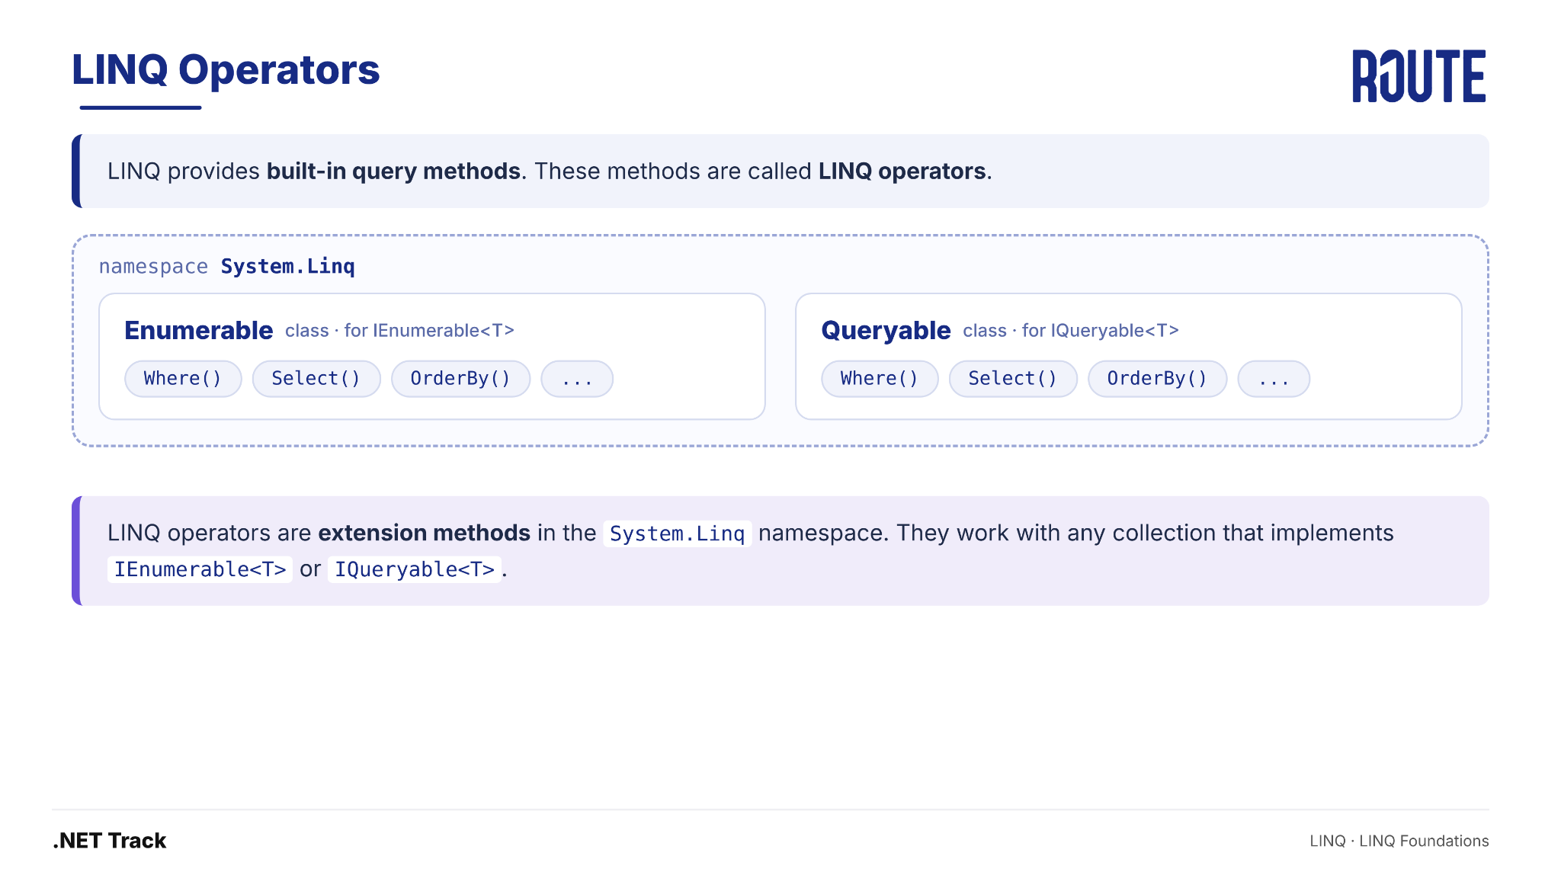
LINQ operators
LINQ · LINQ Foundations

Slide 24
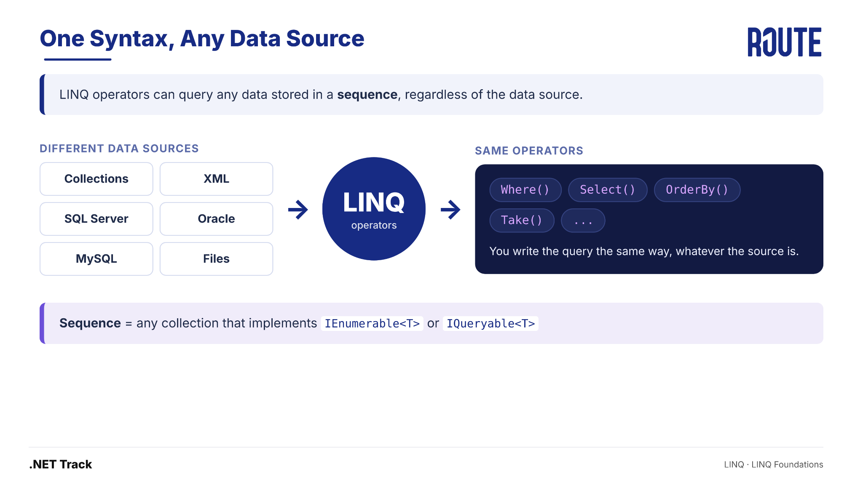
One Syntax , Any Data Source
LINQ · LINQ Foundations

Slide 25
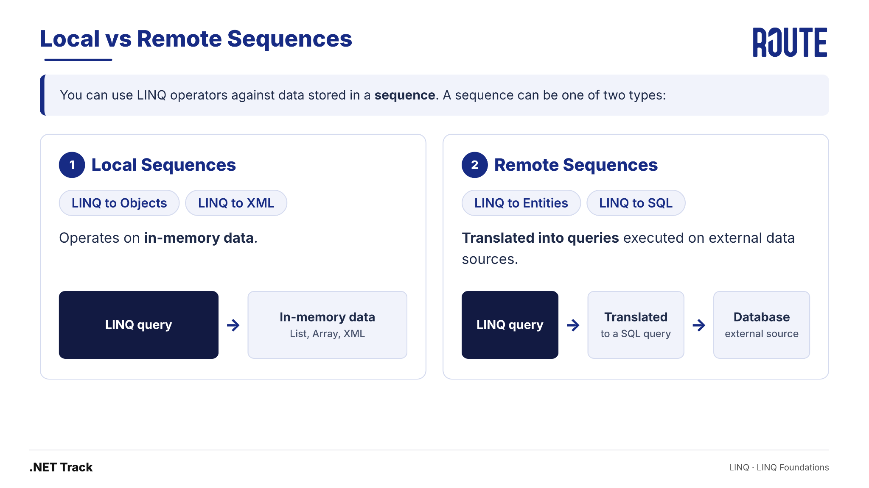
Local vs Remote Sequences
LINQ · LINQ Foundations

Slide 26
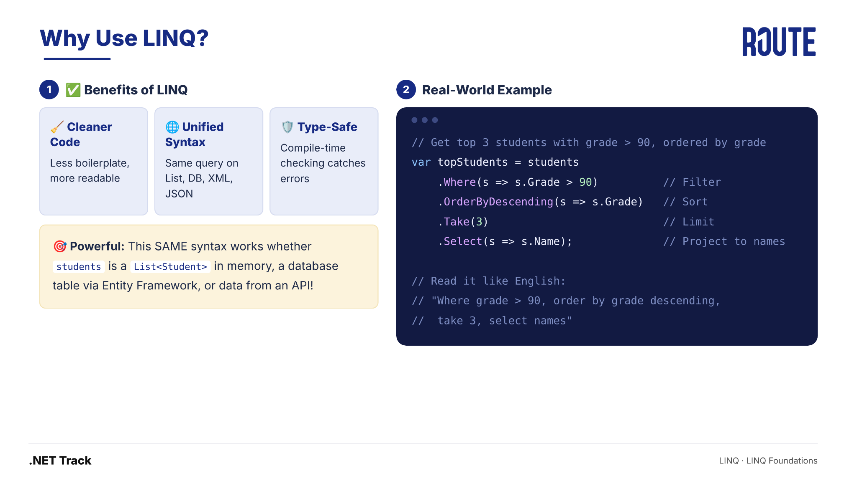
Why Use LINQ?
LINQ · LINQ Foundations

Slide 27
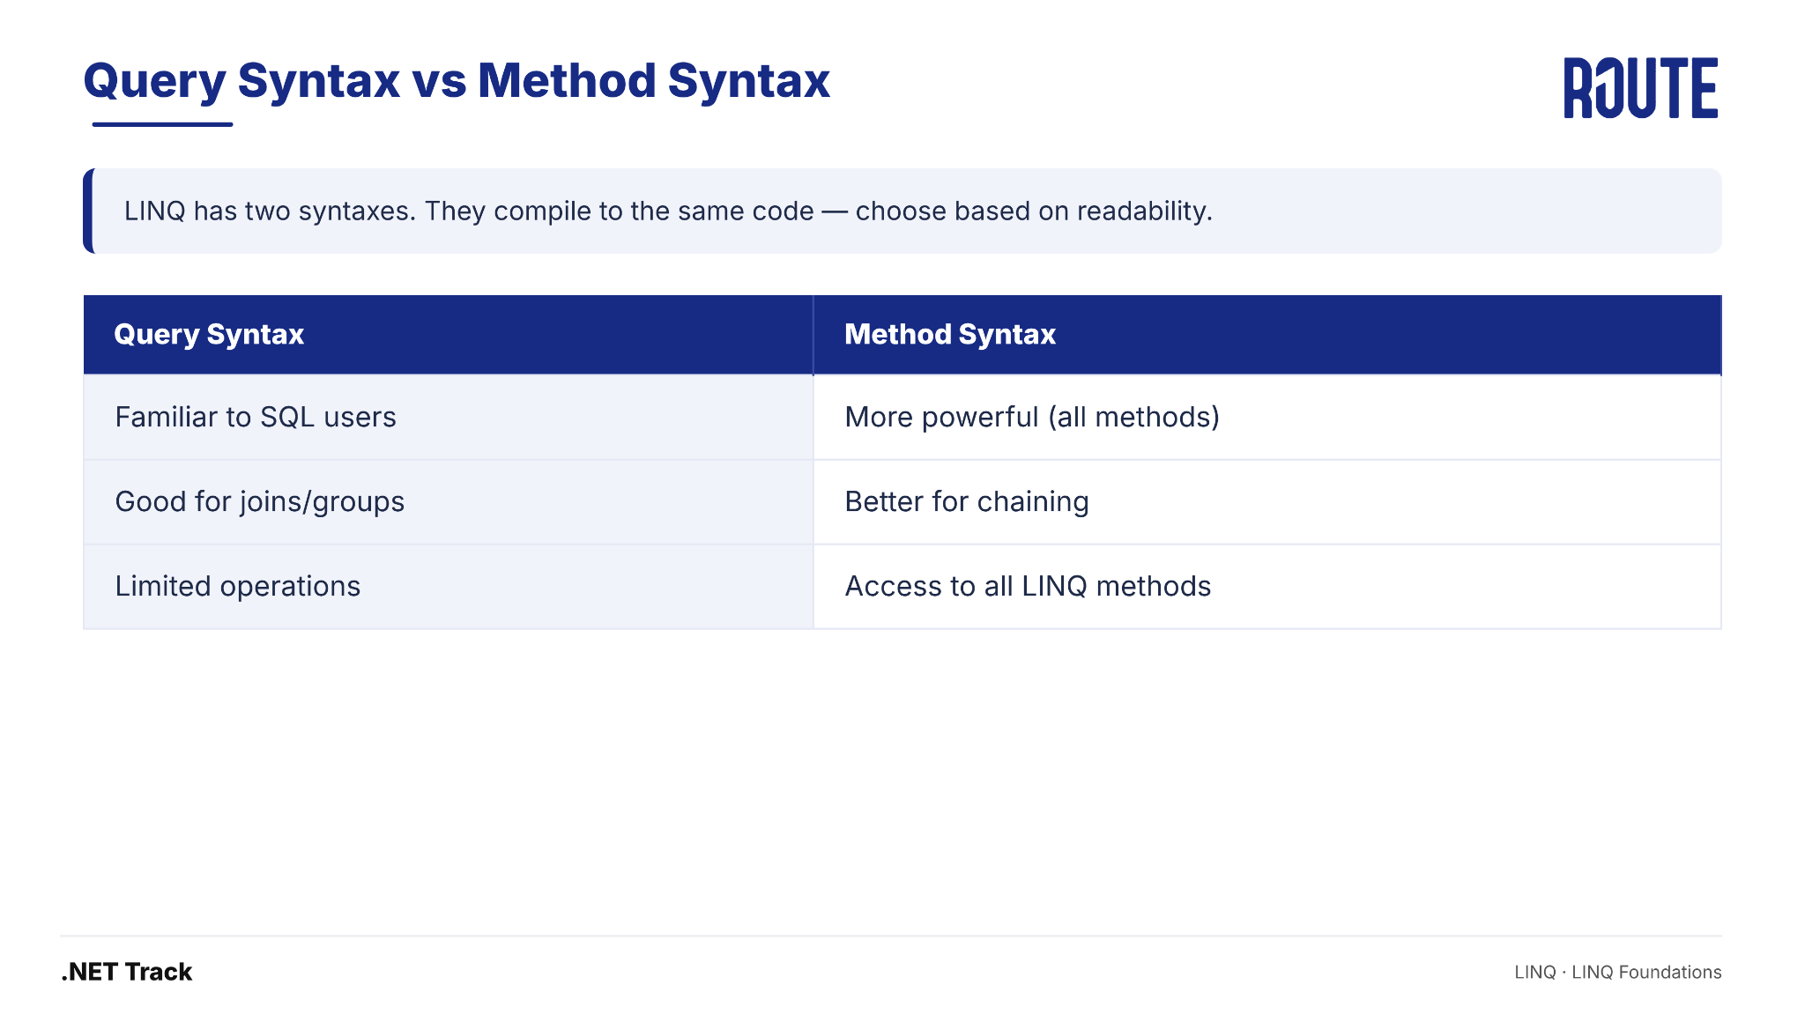
Query Syntax vs Method Syntax
LINQ · LINQ Foundations

Slide 28
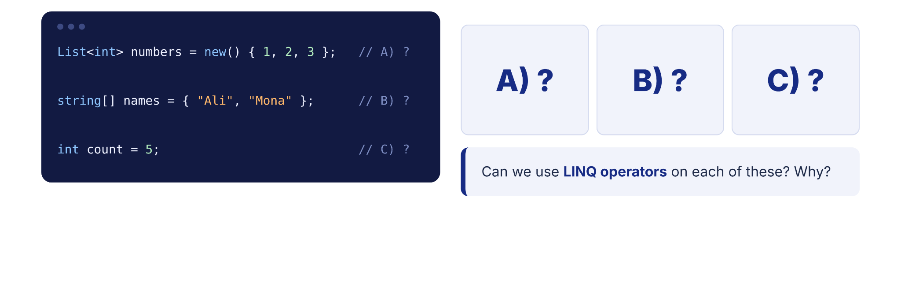
Quick Check
LINQ · LINQ Foundations

Slide 29
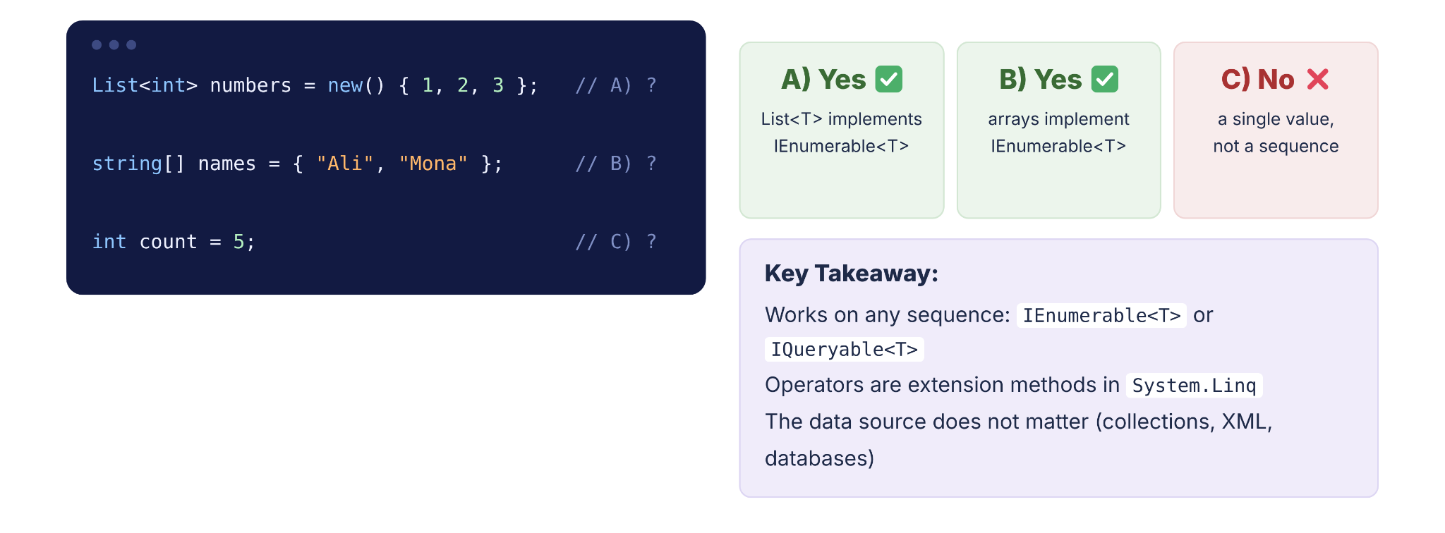
Quick Check
LINQ · LINQ Foundations

Slide 30
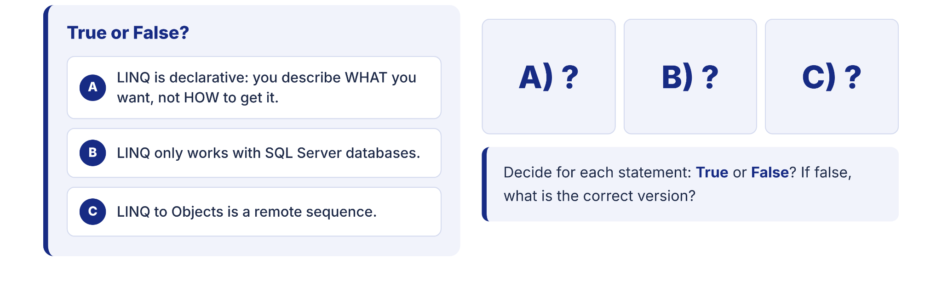
Quick Check
LINQ · LINQ Foundations

Slide 31
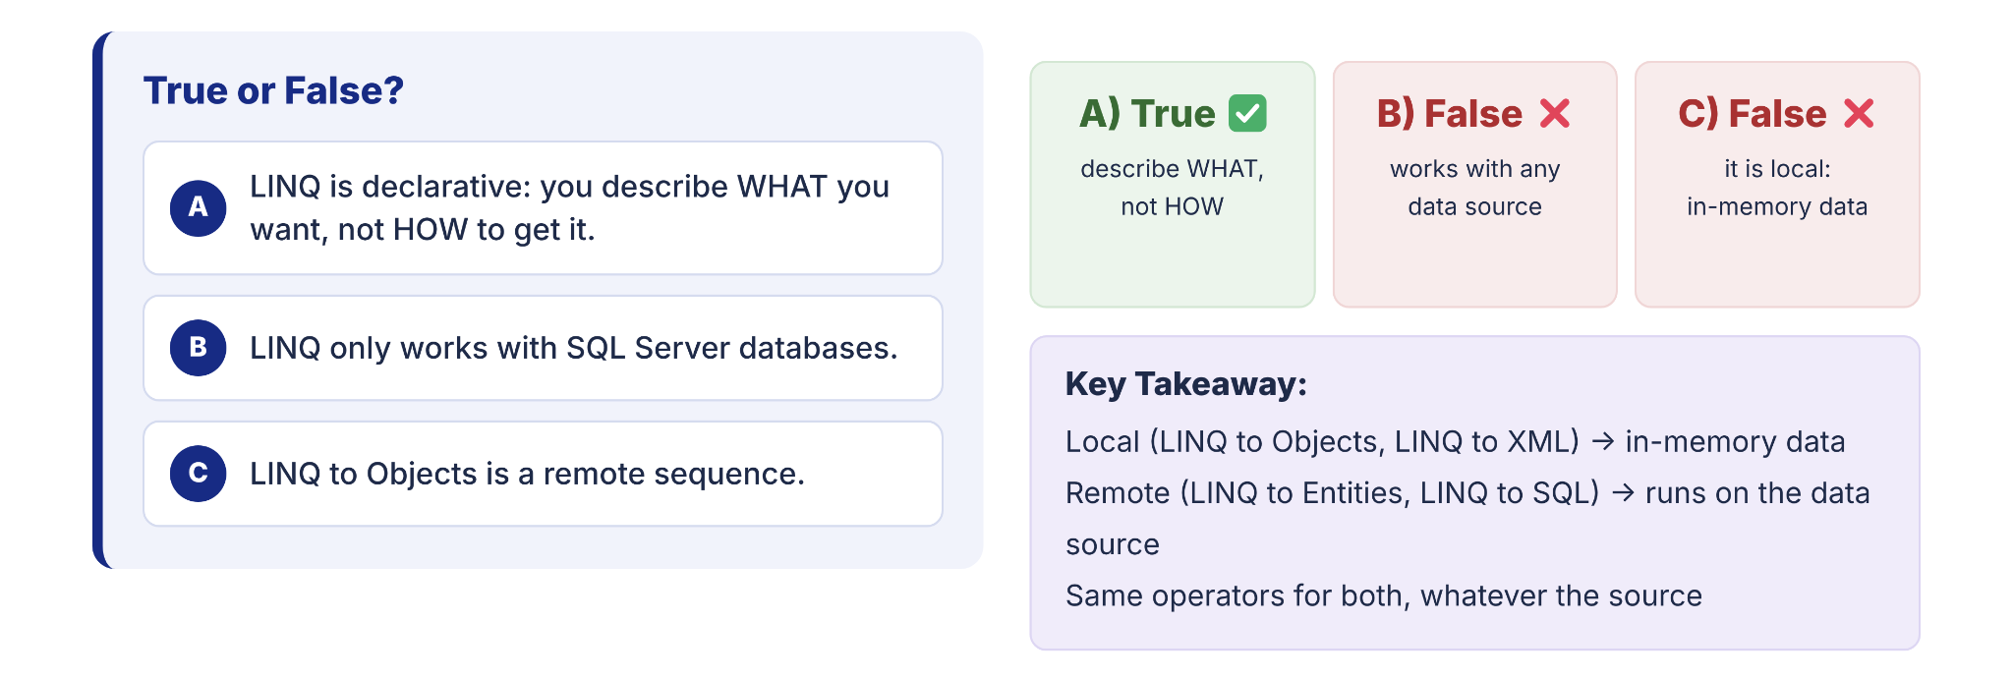
Quick Check
LINQ · LINQ Foundations

Slide 32
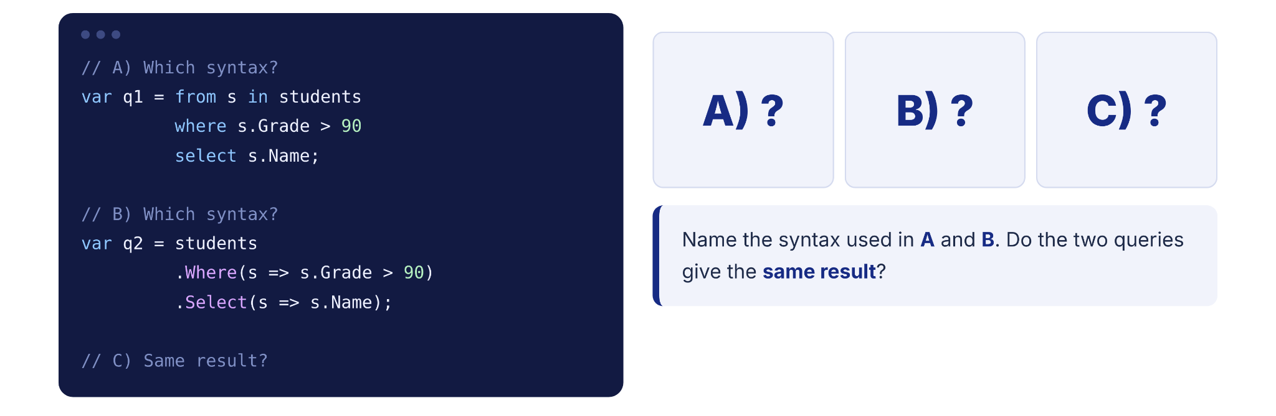
Quick Check
LINQ · LINQ Foundations

Slide 33
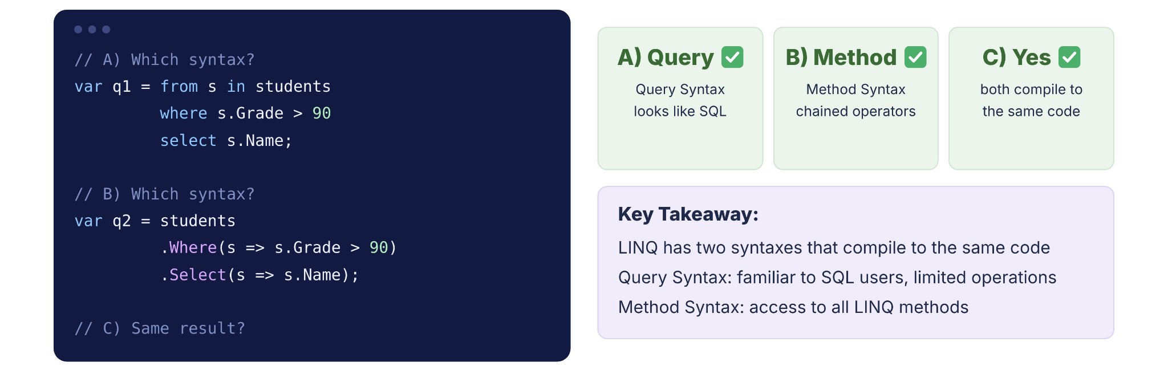
Quick Check
LINQ · LINQ Foundations

Slide 34
Quick Recap

Slide 35
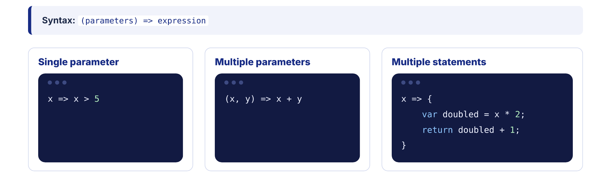
Quick Recap — Lambda Expressions
LINQ · Quick Recap

Slide 36
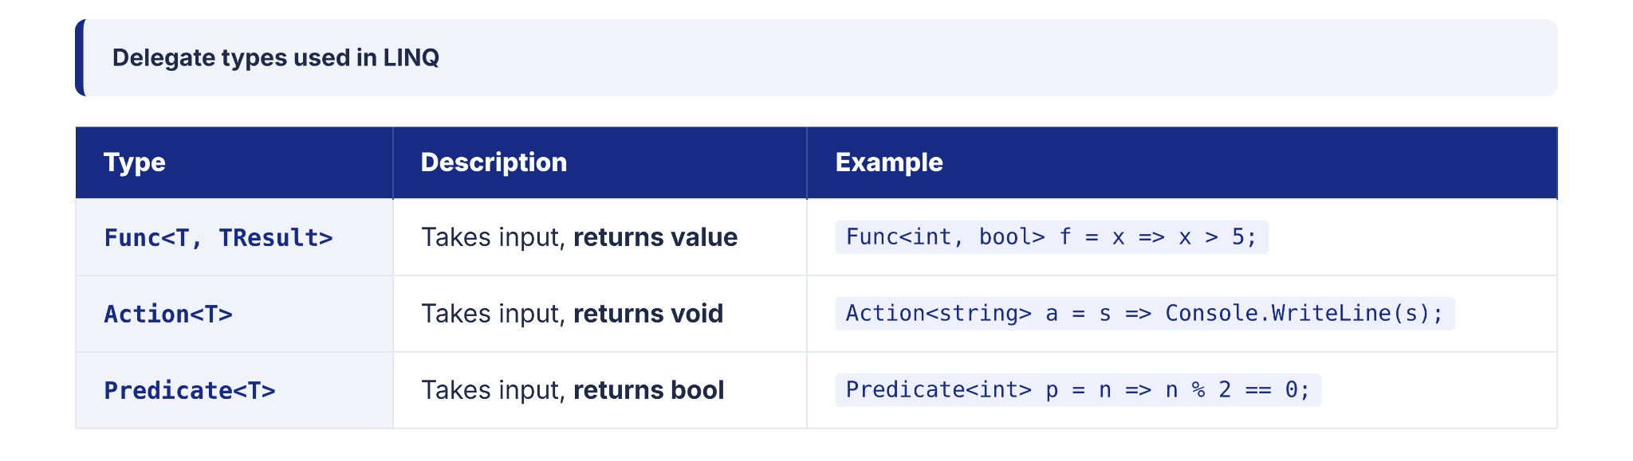
Quick Recap — Delegates
LINQ · Quick Recap

Slide 37
SECTION 04
04
Deferred vs Immediate Execution
Understanding WHEN your query actually runs — the #1 source of LINQ bugs

Slide 38
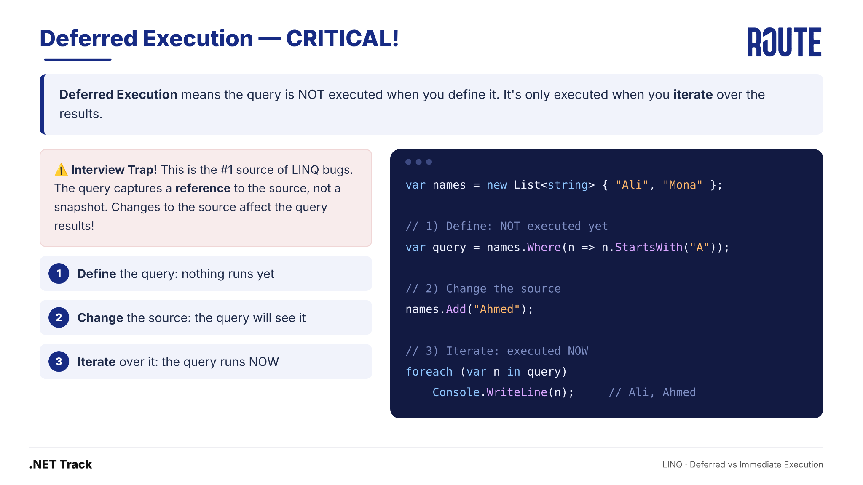
Deferred Execution
LINQ · Deferred vs Immediate Execution

Slide 39
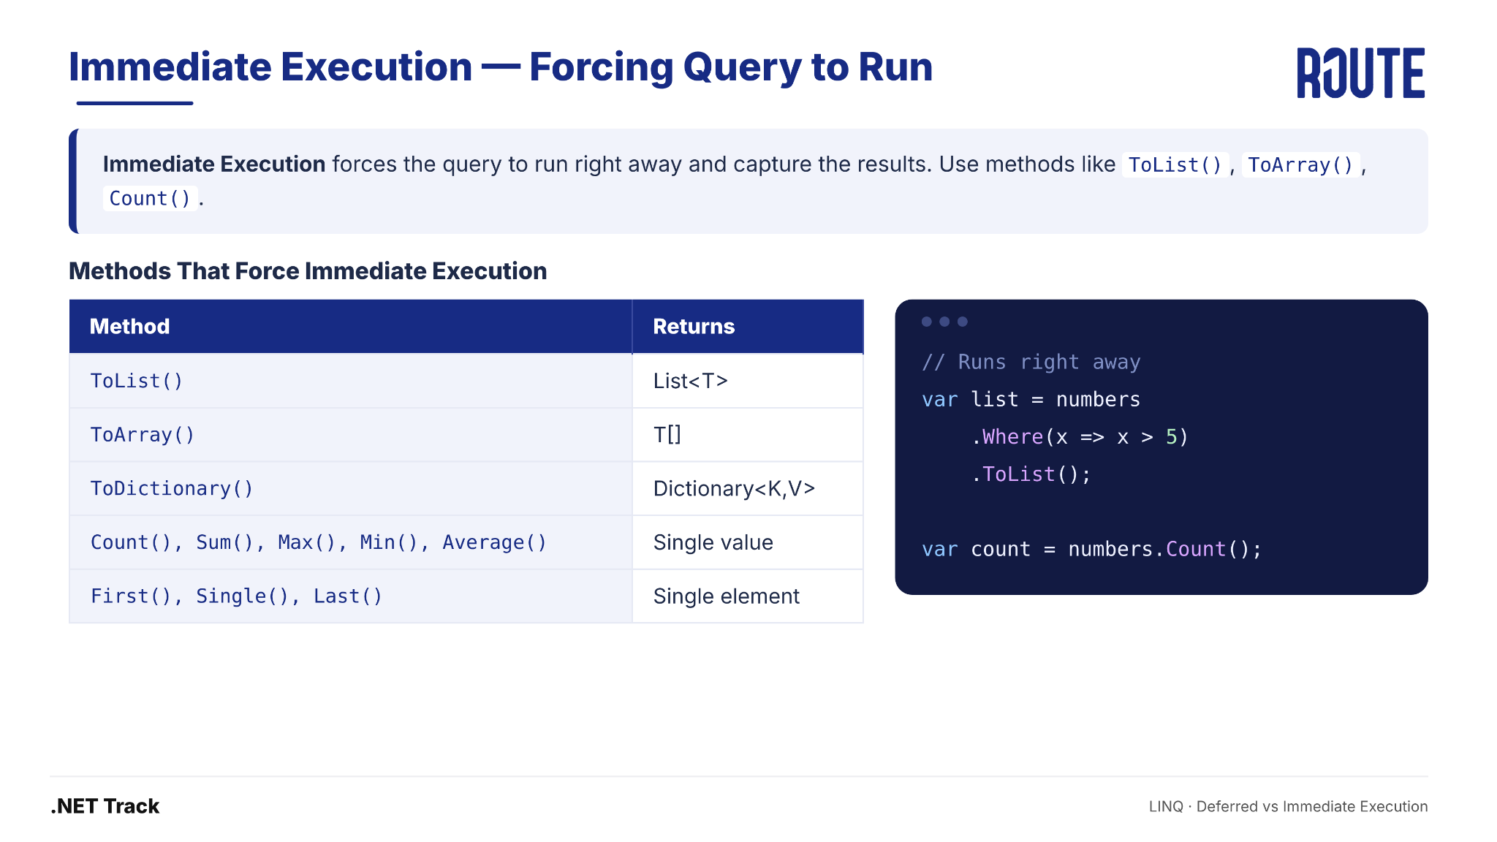
Immediate Execution — Forcing Query to Run
LINQ · Deferred vs Immediate Execution

Slide 40
Deferred vs Immediate — Visual Analogy
📝
🍽️
// 📝 Recipe (Deferred) — instructions only
var recipe = numbers.Where(x => x > 5);
// 🍽️ Cooked Meal (Immediate) — results now
var meal = numbers.Where(x => x > 5).ToList();
Deferred = Recipe
Immediate = Cooked Meal
You write the instructions.
Nothing is cooked yet.
If you change ingredients before cooking,
the meal changes too!
You cook it RIGHT NOW.
The meal is ready and frozen.
If you change ingredients after,
the meal stays the same!
LINQ · Deferred vs Immediate Execution

Slide 41
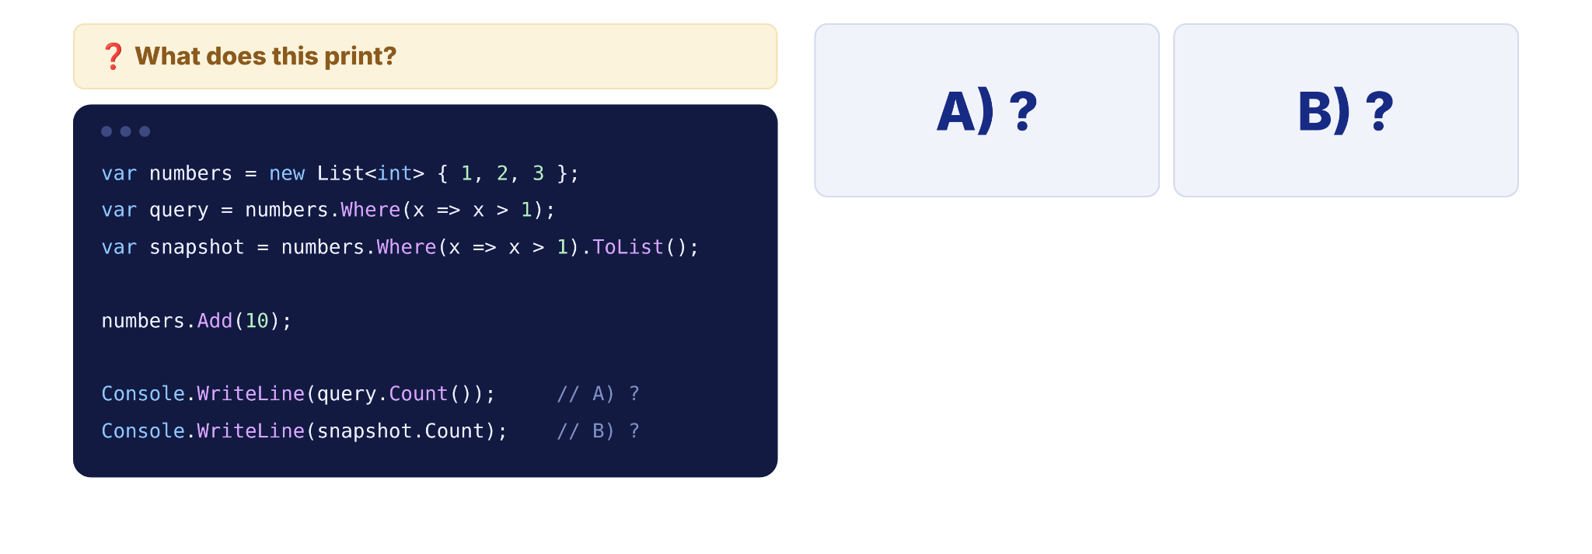
Quick Check
LINQ · Deferred vs Immediate Execution

Slide 42
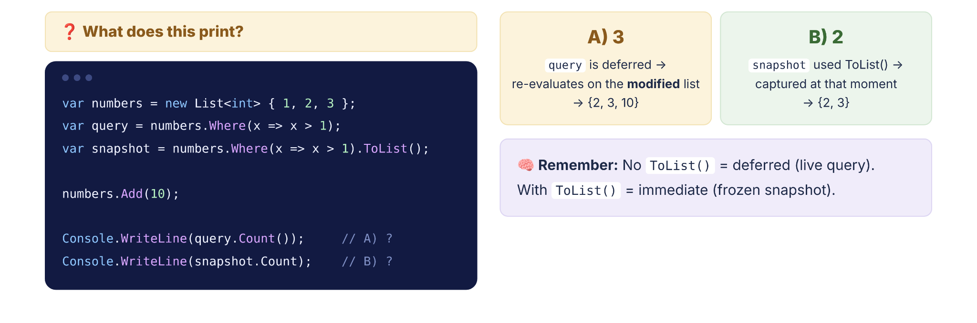
Quick Check
LINQ · Deferred vs Immediate Execution

Slide 43
SECTION 05
05
Filtering
Selecting elements with Where and OfType

Slide 44
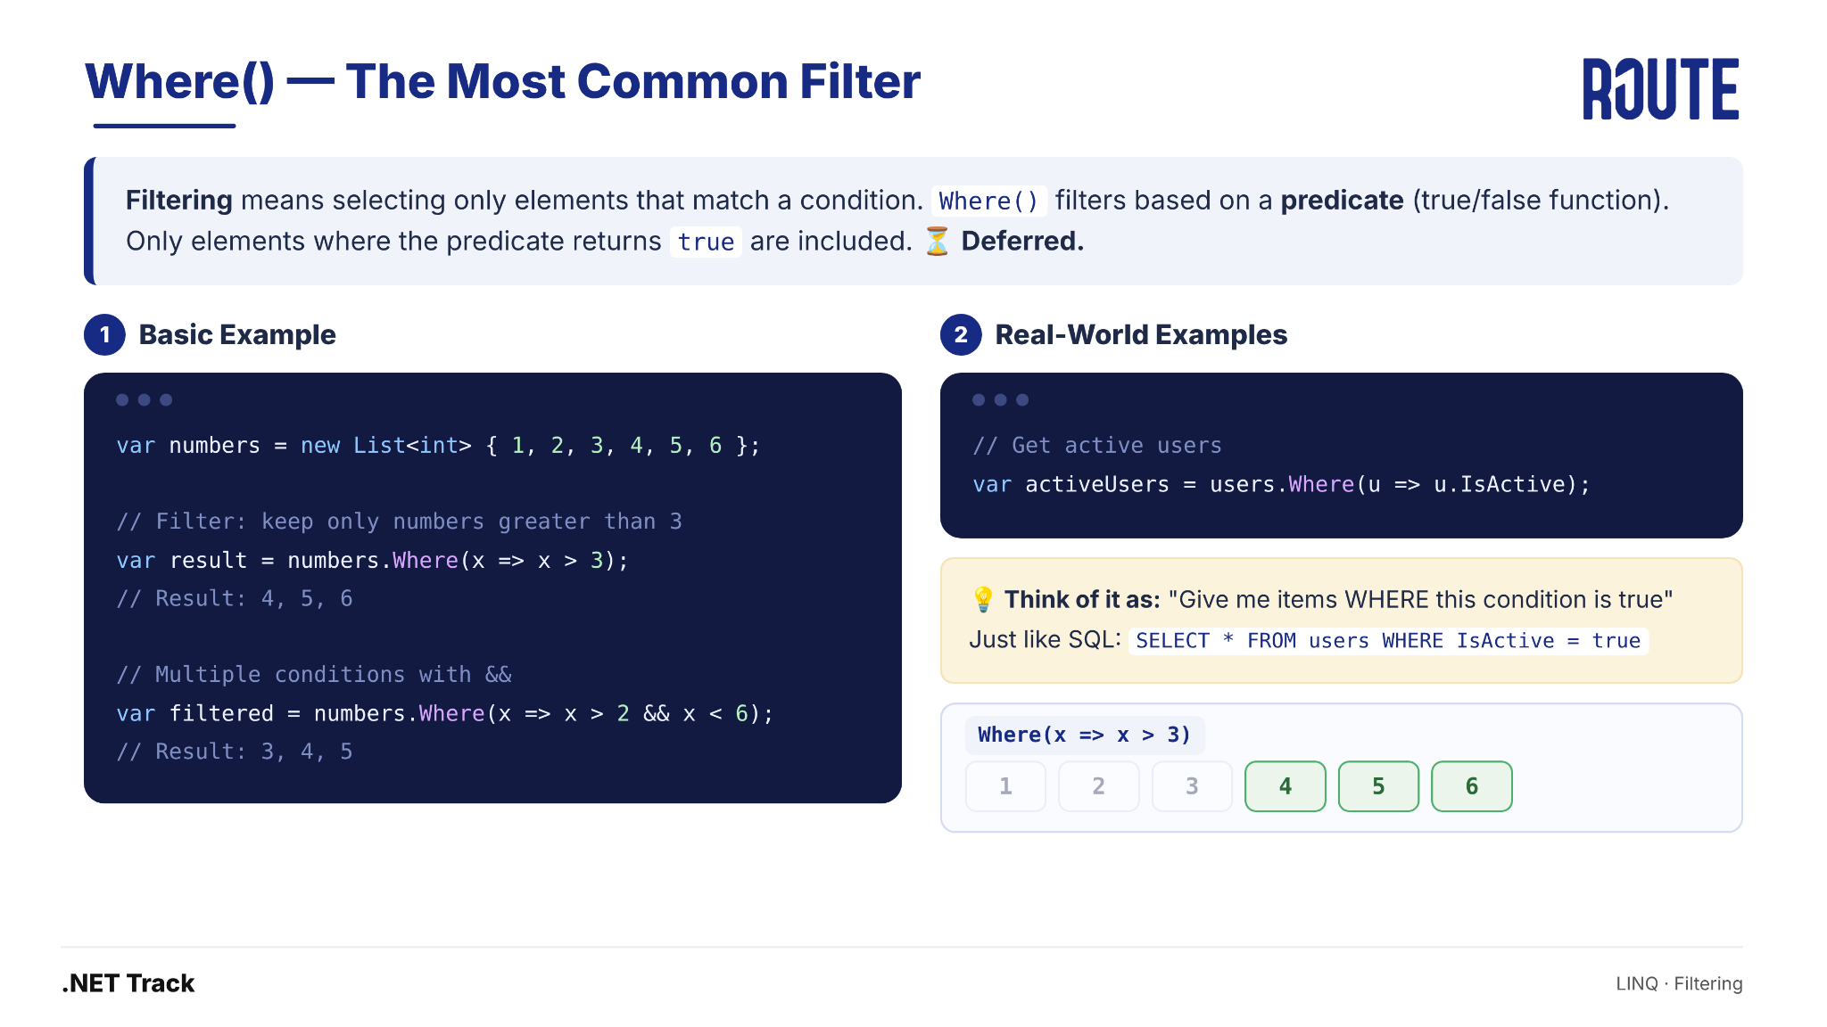
Where() — The Most Common Filter
LINQ · Filtering

Slide 45
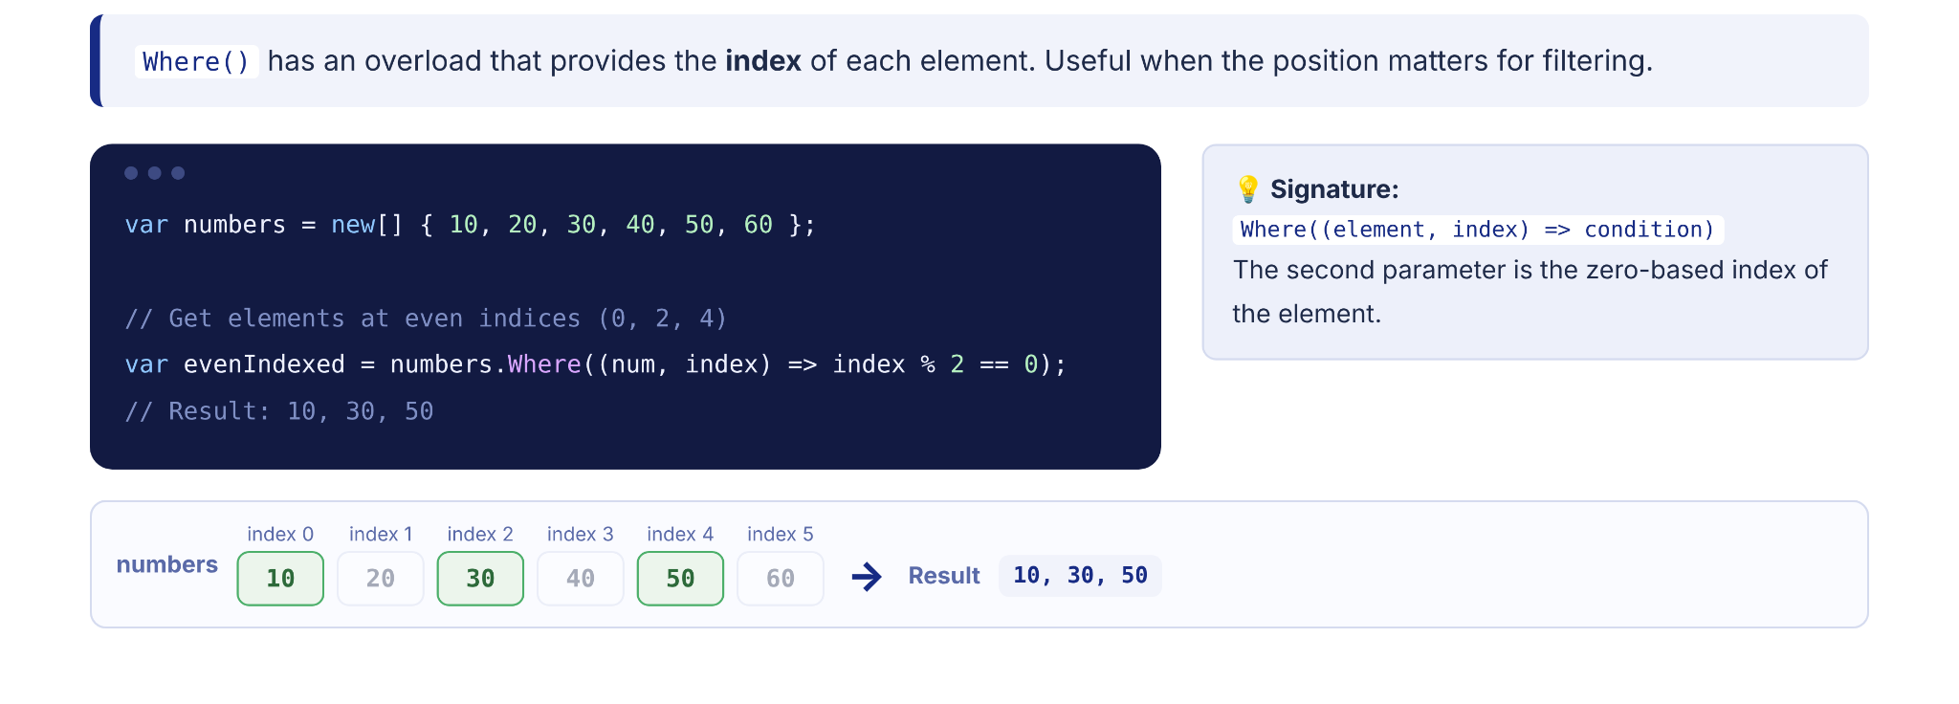
Where() — Index Overload
LINQ · Filtering

Slide 46
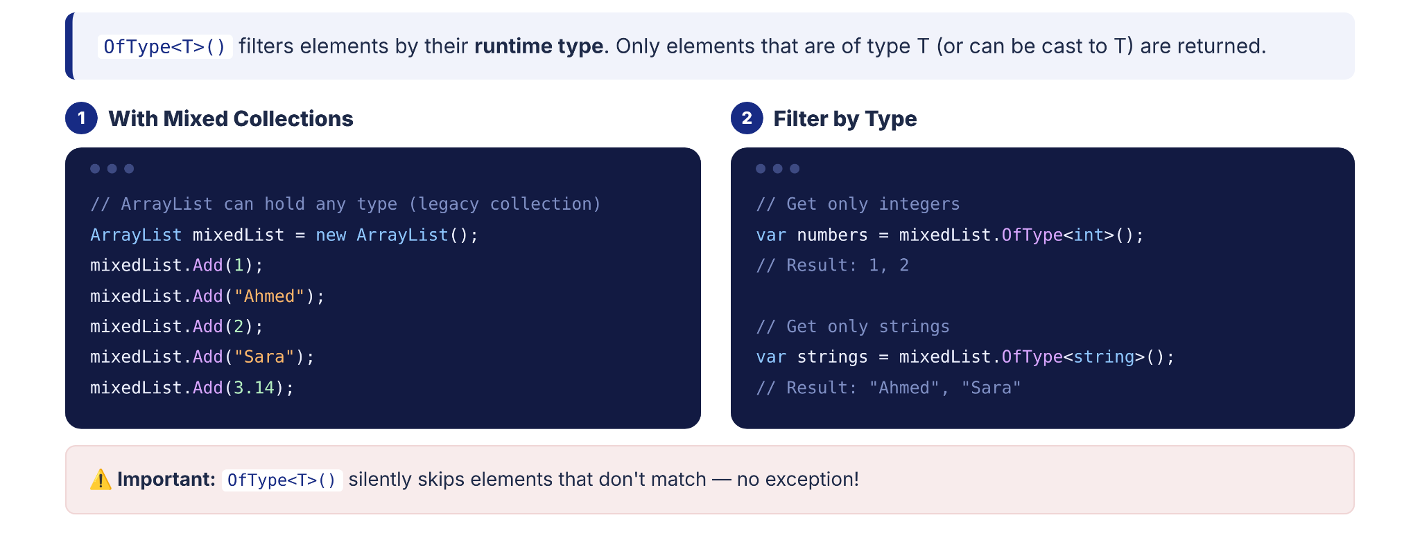
OfType<T>() — Filter by Type
LINQ · Filtering

Slide 47
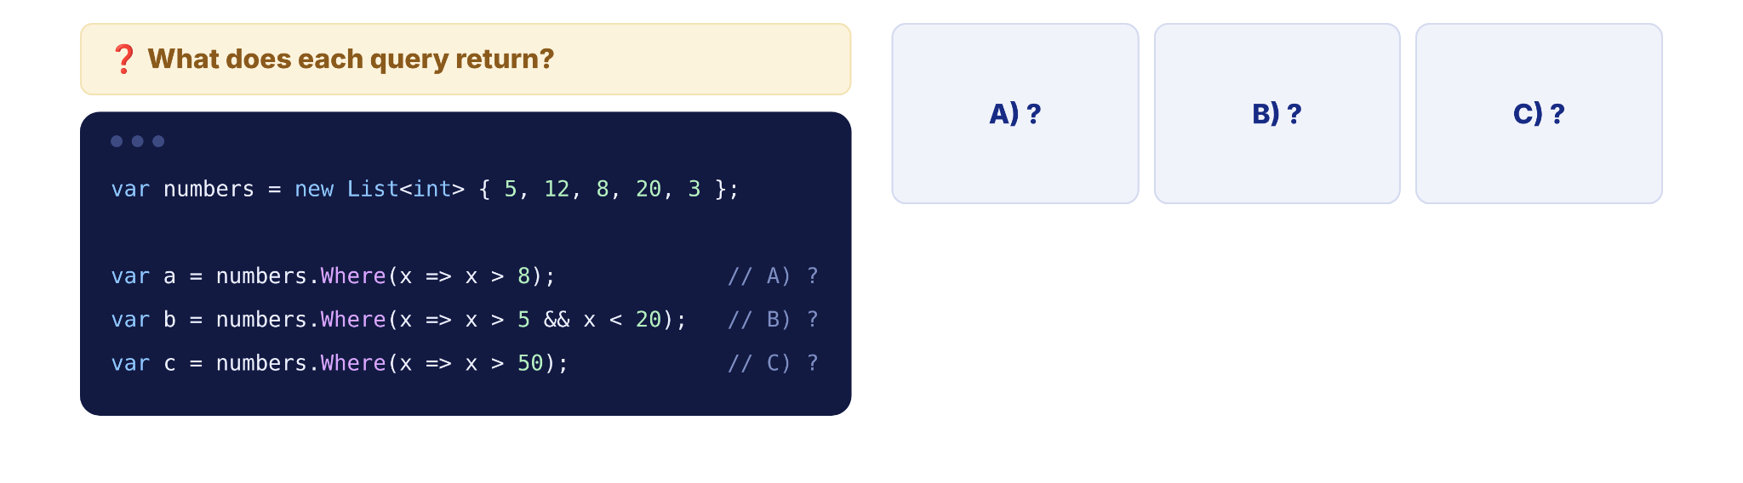
Quick Check
LINQ · Filtering

Slide 48
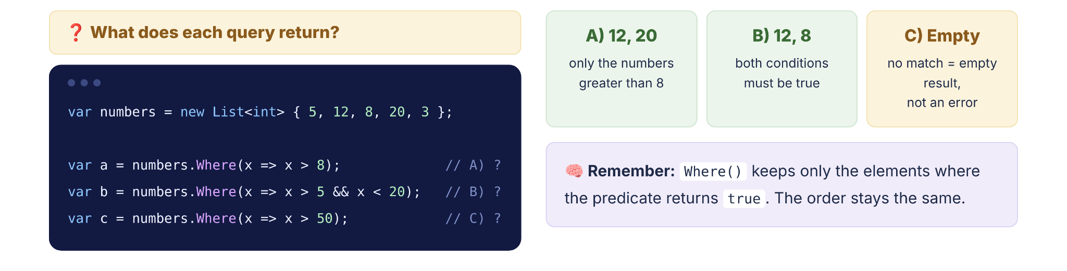
Quick Check
LINQ · Filtering

Slide 49
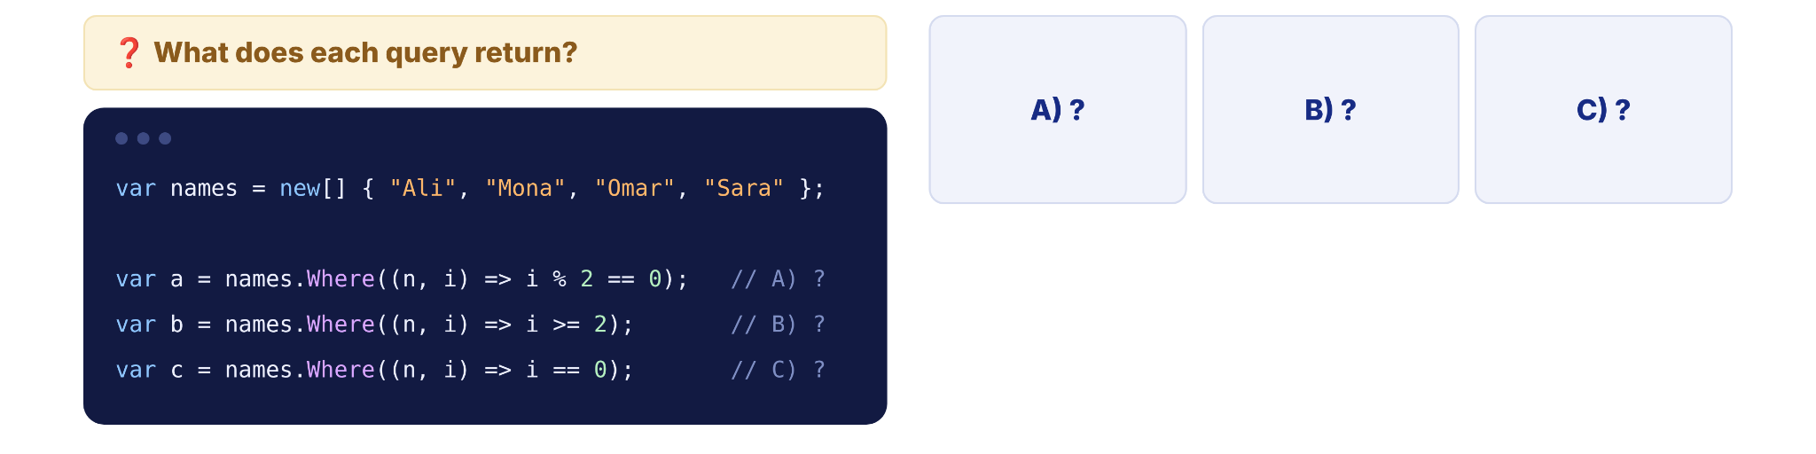
Quick Check
LINQ · Filtering

Slide 50
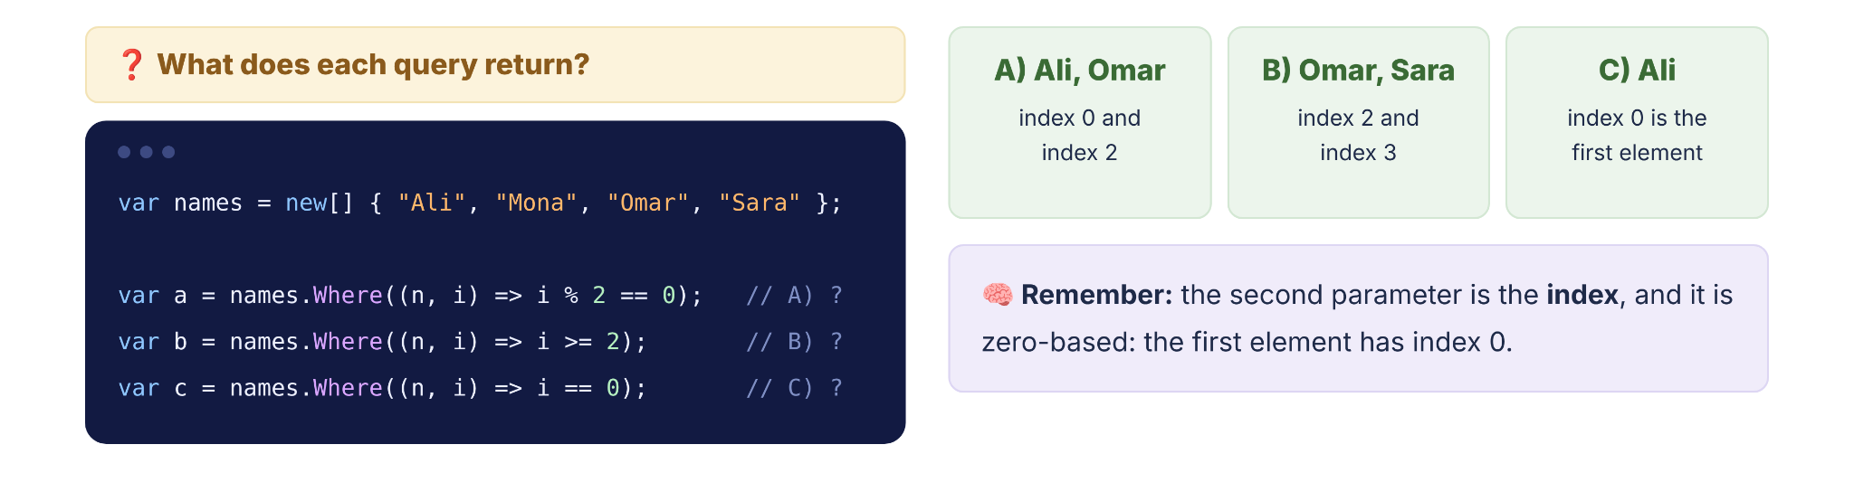
Quick Check
LINQ · Filtering

Slide 51

Quick Check
LINQ · Filtering

Slide 52
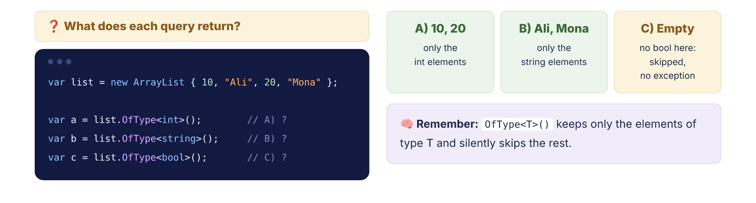
Quick Check
LINQ · Filtering

Slide 53
SECTION 06
06
Projection
Transforming data with Select and SelectMany

Slide 54
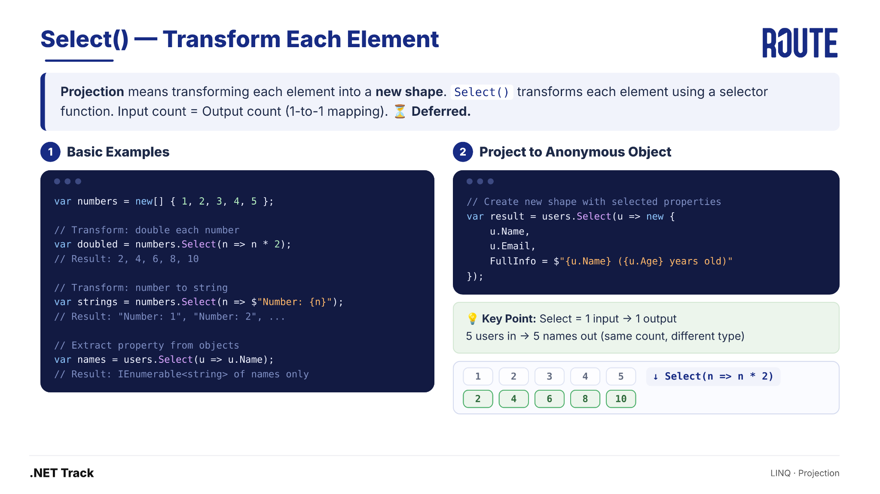
Select() — Transform Each Element
LINQ · Projection

Slide 55
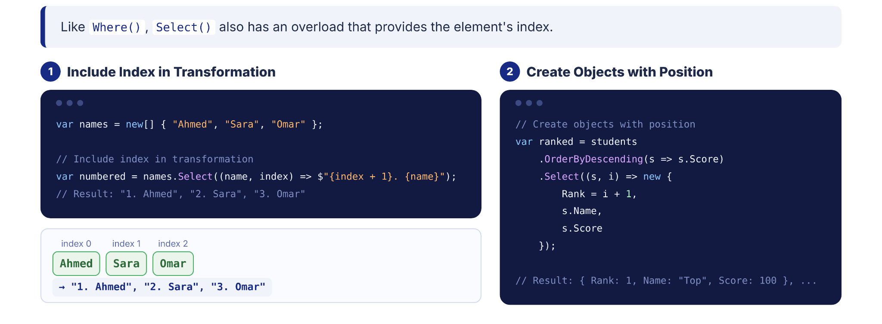
Select() — Index Overload
LINQ · Projection

Slide 56
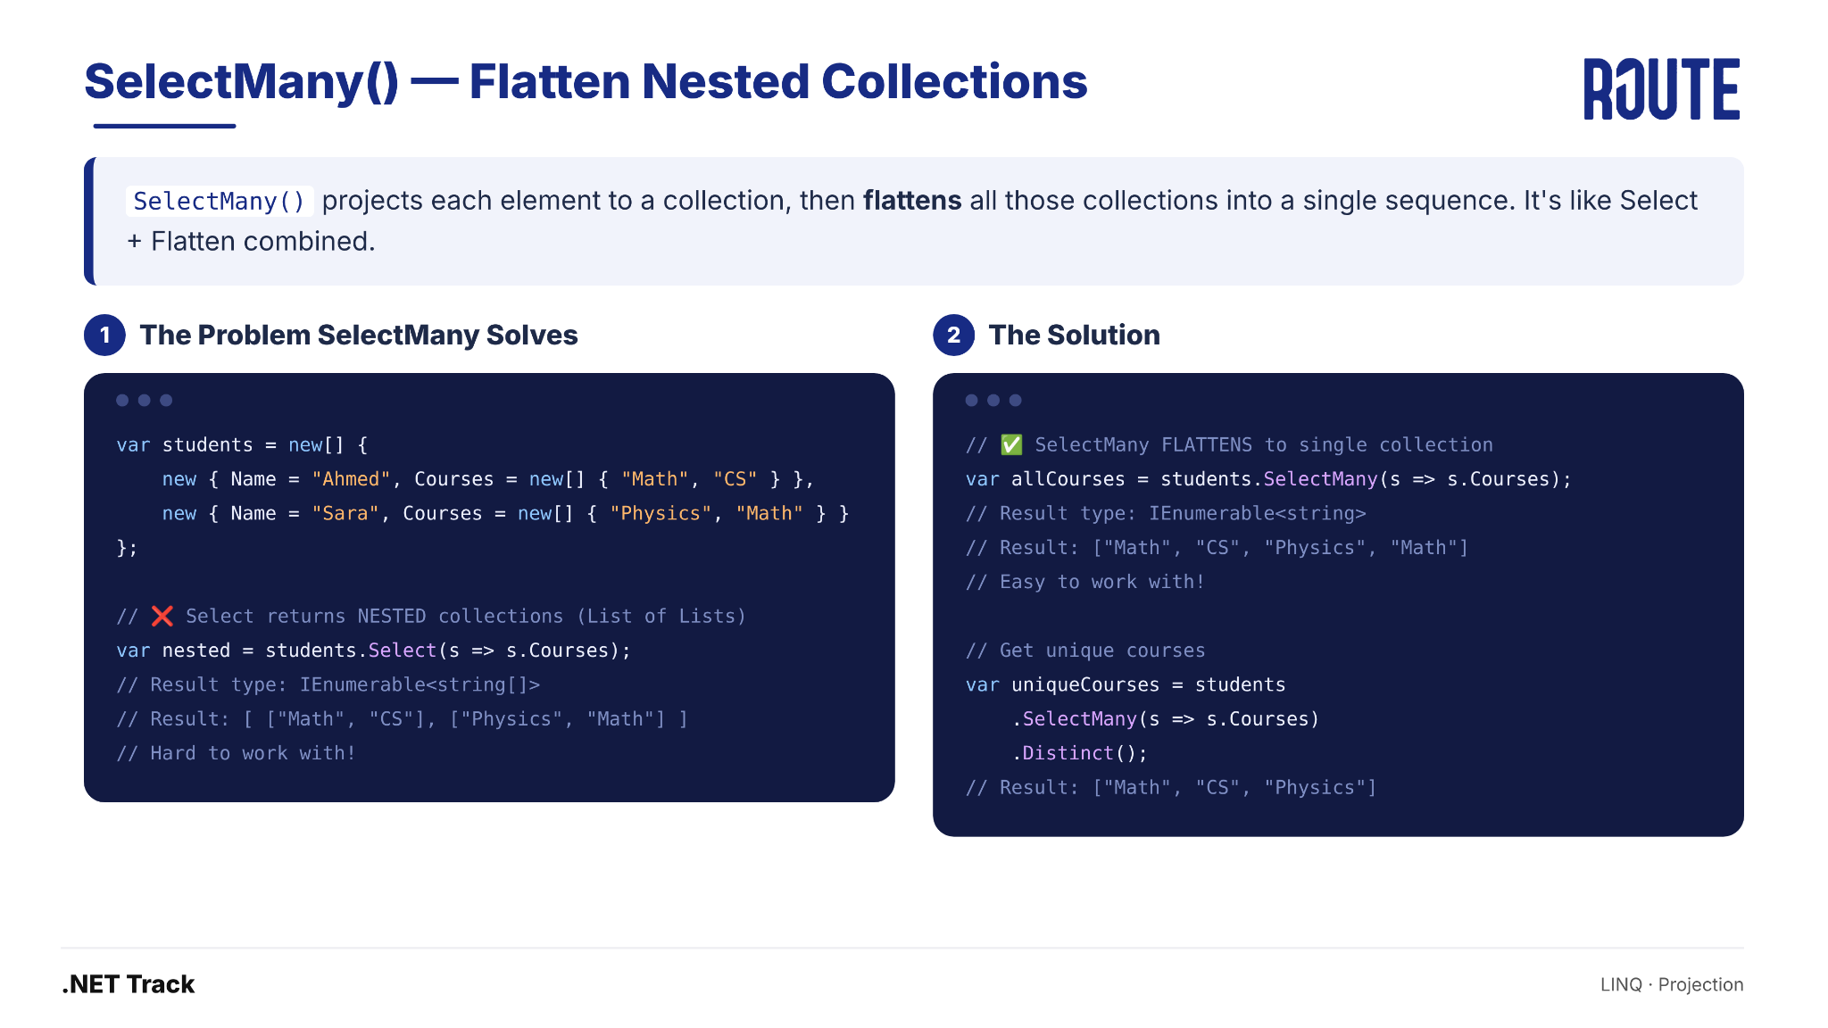
SelectMany() — Flatten Nested Collections
LINQ · Projection

Slide 57
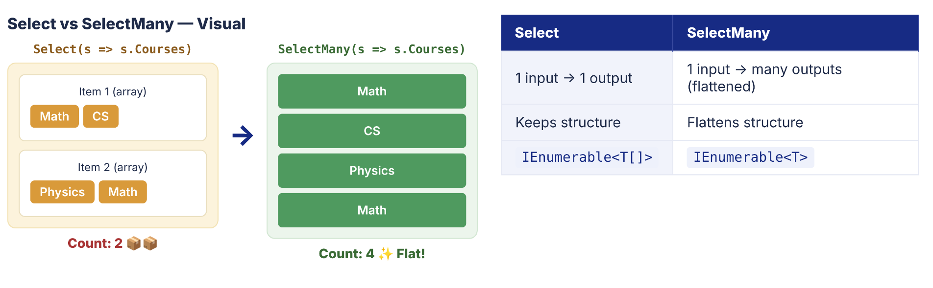
SelectMany() — Visual Comparison
LINQ · Projection

Slide 58
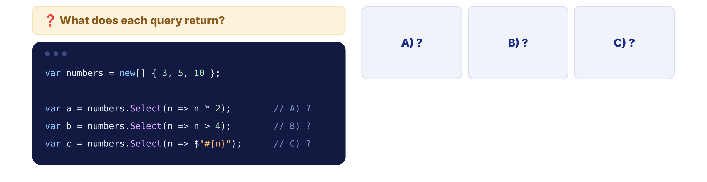
Quick Check
LINQ · Projection

Slide 59
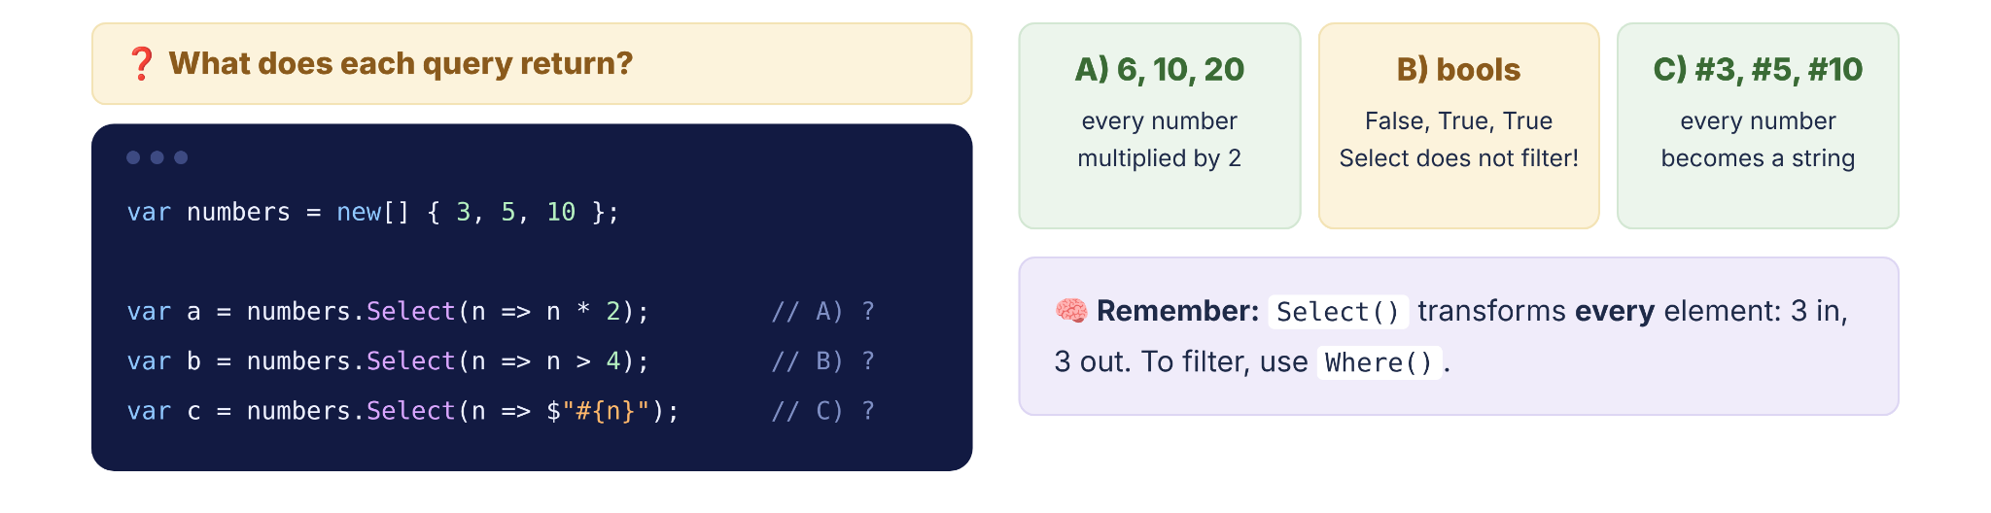
Quick Check
LINQ · Projection

Slide 60
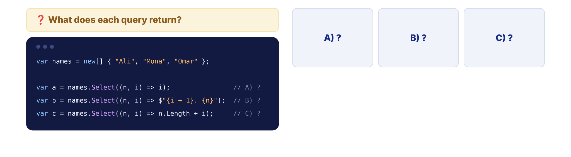
Quick Check
LINQ · Projection

Slide 61
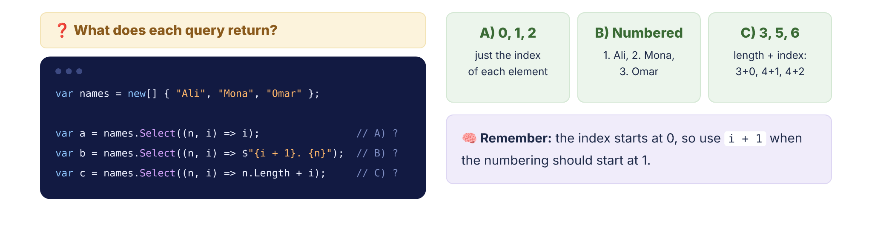
Quick Check
LINQ · Projection

Slide 62
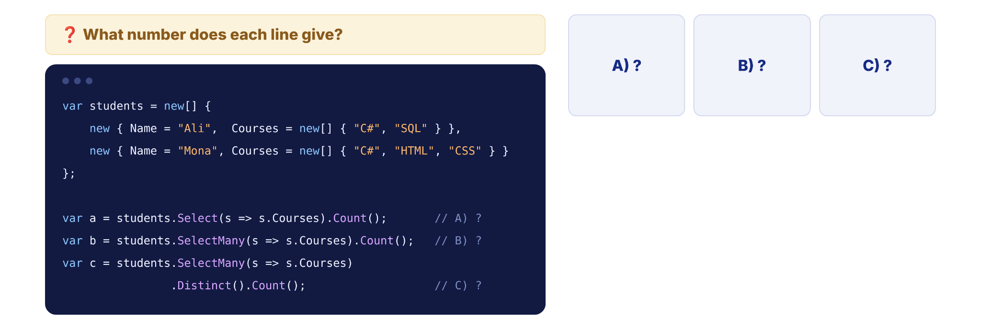
Quick Check
LINQ · Projection

Slide 63
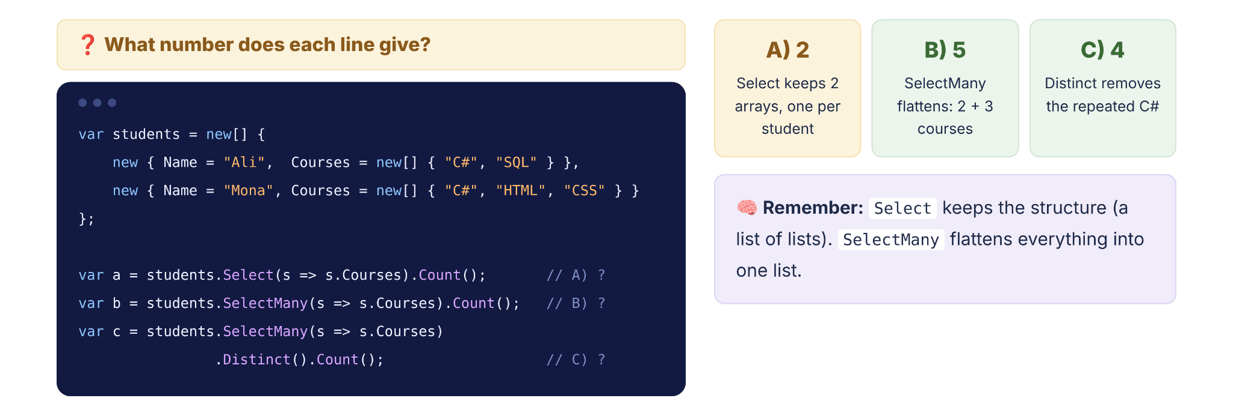
Quick Check
LINQ · Projection

Slide 64
SECTION 07
07
Ordering
Sorting results with OrderBy, ThenBy, and Reverse

Slide 65
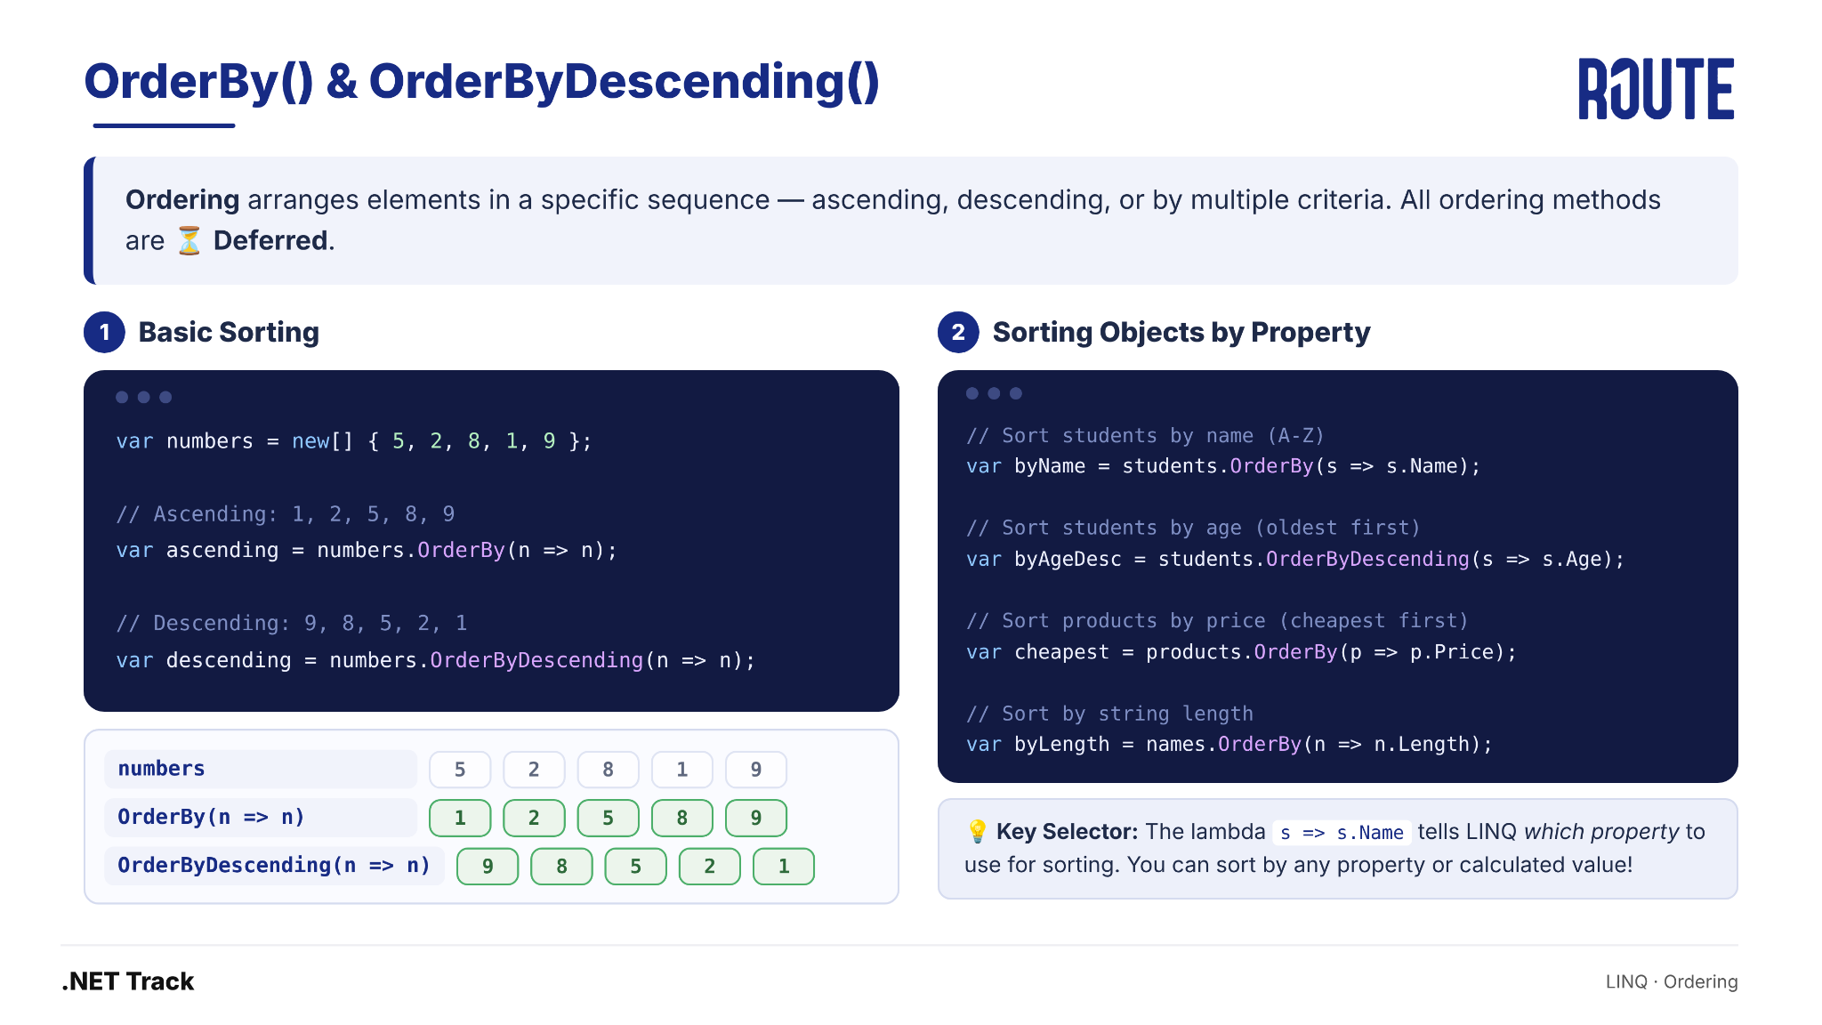
OrderBy() & OrderByDescending()
LINQ · Ordering

Slide 66
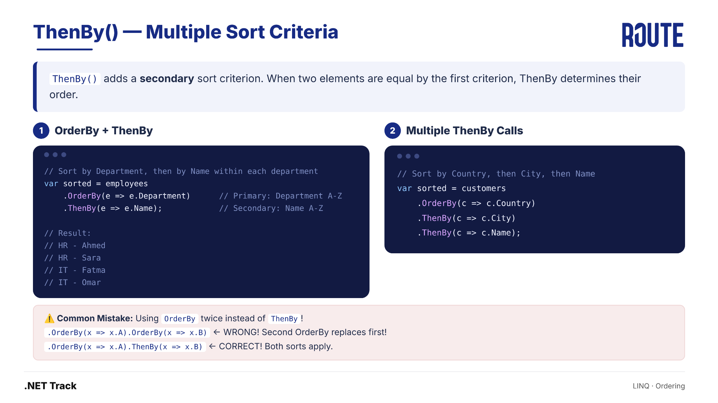
ThenBy() — Multiple Sort Criteria
LINQ · Ordering

Slide 67
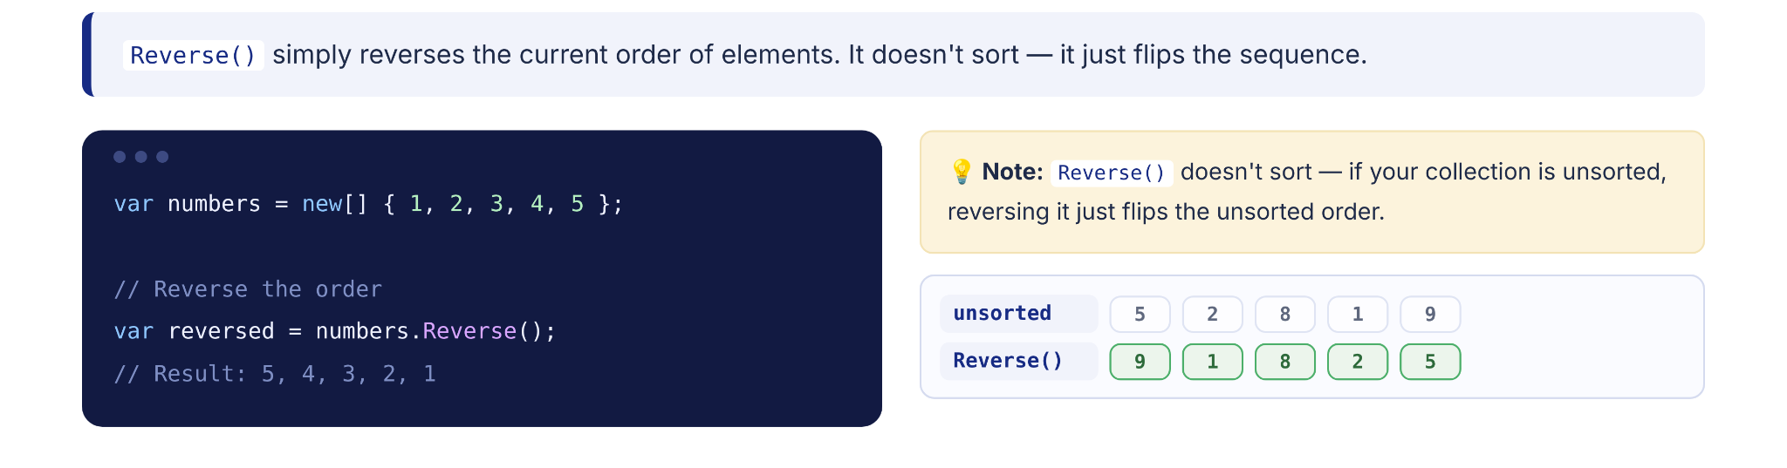
Reverse() — Flip the Order
LINQ · Ordering

Slide 68

Quick Check
LINQ · Ordering

Slide 69
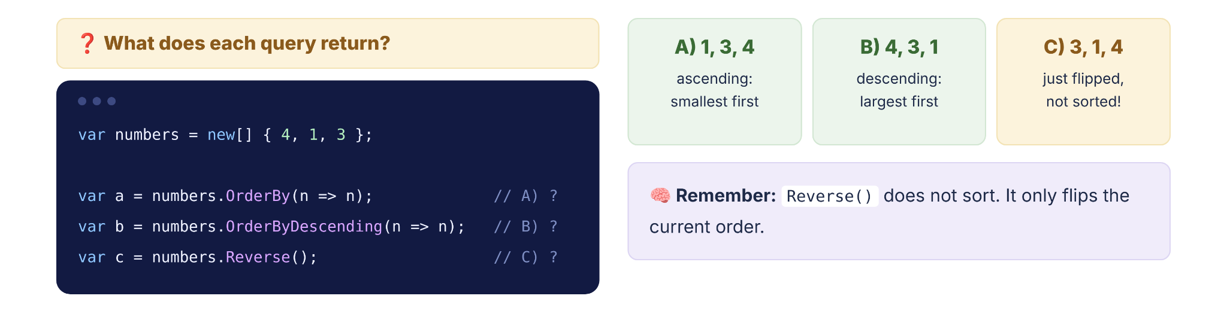
Quick Check
LINQ · Ordering

Slide 70

Quick Check
LINQ · Ordering

Slide 71

Quick Check
LINQ · Ordering

Slide 72
SECTION 09
09
Mini Exercises
Test your understanding with predict-the-output challenges

Slide 73
Exercise #1
EXERCISE 1 OF 8
✅ Output: 5
var x = "Ahmed";
dynamic y = x;
y = 10;
Console.WriteLine(x.Length);
x is var → type is string (fixed forever). y = 10 makes y point to a new int — x still points to "Ahmed". x.Length = 5.
❓ What is the output?
LINQ · Mini Exercises

Slide 74
Exercise #2
EXERCISE 2 OF 8
✅ Output: "510"
dynamic a = 5;
dynamic b = "10";
var result = a + b;
Console.WriteLine(result);
At runtime: 5 + "10" — C# converts int to string for concatenation. Result is string "510", not mathematical 15!
❓ What is the output?
LINQ · Mini Exercises

Slide 75
Exercise #3
EXERCISE 3 OF 8
❌ Code A: Compile Error! ✅ Code B: 5
// Code A
object x = "Hello";
int len = x.Length;
// Code B
dynamic y = "Hello";
int len2 = y.Length;
object only exposes object methods — needs casting. dynamic skips compile-time checking, resolves .Length at runtime.
❓ What is the output?
LINQ · Mini Exercises

Slide 76
Exercise #4
EXERCISE 4 OF 8
💥 Runtime Error! RuntimeBinderException
var numbers = new[] { 1, 2, 3 };
dynamic d = numbers;
d[0] = "Hello";
Console.WriteLine(numbers[0]);
It compiles (dynamic skips checks), but at runtime the array is int[] — can't store strings!
❓ What is the output?
LINQ · Mini Exercises

Slide 77
Exercise #5
EXERCISE 5 OF 8
✅ Output: 2, 3, 4
var numbers = new List<int> { 1, 2, 3 };
var query = numbers.Where(n => n > 1);
numbers.Add(4);
Console.WriteLine(string.Join(", ", query));
Query is NOT executed when defined! numbers.Add(4) modifies the source. When string.Join iterates → query runs NOW with {1,2,3,4}.
❓ What is the output?
LINQ · Mini Exercises

Slide 78
Exercise #6
EXERCISE 6 OF 8
✅ Output: 2 (NOT 4!)
var data = new List<List<int>> {
new List<int> { 1, 2 },
new List<int> { 3, 4 }
};
var result = data.Select(x => x);
Console.WriteLine(result.Count());
Select(x => x) returns each inner list as-is → still 2 lists. Need SelectMany to flatten and get 4 items.
❓ What is the output?
LINQ · Mini Exercises

Slide 79
Exercise #7
EXERCISE 7 OF 8
❓ What is the output?
var items = new[] {
new { Name = "A", Value = 2 },
new { Name = "C", Value = 1 },
new { Name = "B", Value = 3 }
};
var result = items.OrderBy(x => x.Name).OrderBy(x => x.Value);
foreach(var r in result) Console.Write(r.Name + " ");
✅ Output: C A B (sorted by Value only!)
Second OrderBy replaces the first! Items sorted by Value (1,2,3). To sort by Name THEN Value: .OrderBy(x => x.Name).ThenBy(x => x.Value)
LINQ · Mini Exercises

Slide 80
Exercise #8
EXERCISE 8 OF 8
✅ Output: 1, 2, 3, 4, 5 (unchanged!)
var numbers = new List<int> { 1, 2, 3, 4, 5 };
numbers.Where(n => n > 3);
Console.WriteLine(string.Join(", ", numbers));
Where() returns a NEW sequence — it doesn't modify the original! The result was not stored anywhere. Fix: var filtered = numbers.Where(n => n > 3).ToList();
❓ What is the output?
LINQ · Mini Exercises

Slide 81
QUESTIONS?
Thank You
.NET Track

